Slide 1


Drones in Agriculture
What kinds of new technologies could be created in the future of agriculture?

Slide 2
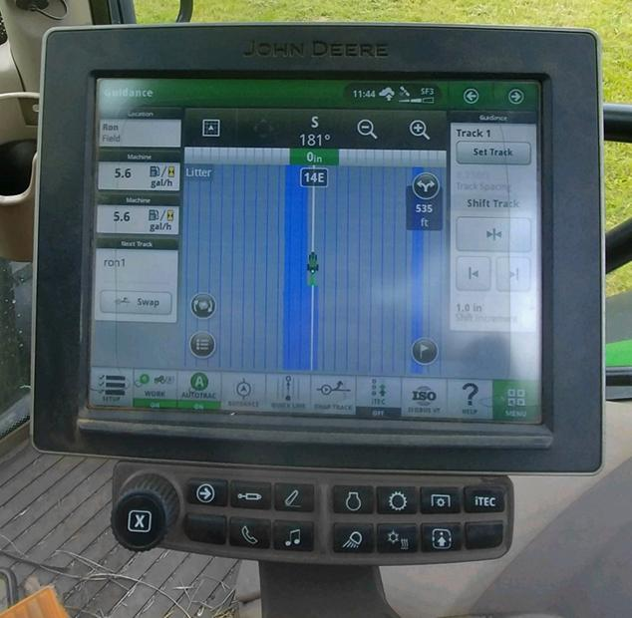
History of Precision Agriculture
Precision agriculture is a farming management system that uses technology to collect and interpret data, which can make farming more efficient and sustainable.
According to Michigan State University AgBioResearch, precision agriculture “originated in the 1990s when farmers started using GPS, geographic information systems (GIS), yield monitors and other software to collect field data.”
Agricultural researcher Dr. Amanda Ashworth says that an example of precision agriculture is “tractor guidance . . . that uses GPS and can result in accuracy within one centimeter when planting, spraying herbicide, or applying fertilizer. This improved precision during field activities can result in fewer overlaps and gaps and overall improved efficiencies.”
Notes:
Michigan State University AgBioResearch Article: https://www.canr.msu.edu/news/precision-farming-comes-into-its-own
USDA Agricultural Research Service Article: https://www.ars.usda.gov/oc/utm/benefits-and-evolution-of-precision-agriculture

Slide 3
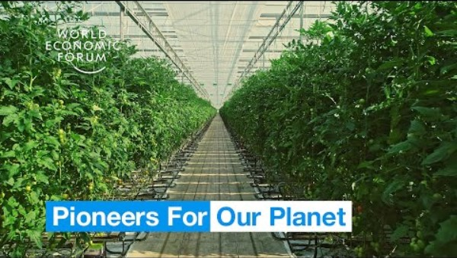
Why Use Precision Agriculture?
Notes:
World Economic Forum” Farmers in the Netherlands are growing more food using less resources”
Video length − 2:54
https://www.youtube.com/watch?v=5clOYWsNhhk&t=1s

Slide 4
Group Discussion Questions on Agriculture
So far, drones have mostly been used in agriculture for monitoring, crop spraying, and data collection.
What are some other scenarios where drones could potentially be used in agriculture?
What kinds of technologies for drones could be useful in these other scenarios?
What could be some possible obstacles and challenges in using drones for agriculture in these other scenarios?
Notes:
Example discussion topics:
Animal herding, drone pollination, planting seeds, harvesting crops, etc.
Animal herding − noise reduction; drone pollination − vibration system to disperse pollen, sensors/imaging to monitor flower pollination success; planting seeds − air cannon; harvesting crops − sensors to detect ripe crops, gentle robotics machinery; etc.
Startup cost, safety around people and animals, sensor accuracy, potential of damaging crops, etc.

Slide 5
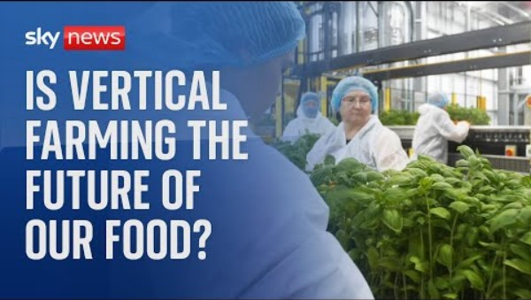
Vertical Farming
Vertical farming is a modern form of agriculture where crops are grown in stacked layers, usually indoors. Precision agriculture techniques are used in vertical farming to increase efficiency and reduce waste.
Notes:
Sky News “Could vertical farming be the future of our food?”
Video length − 3:34
https://www.youtube.com/watch?v=YB9tYRchAh8

Slide 6
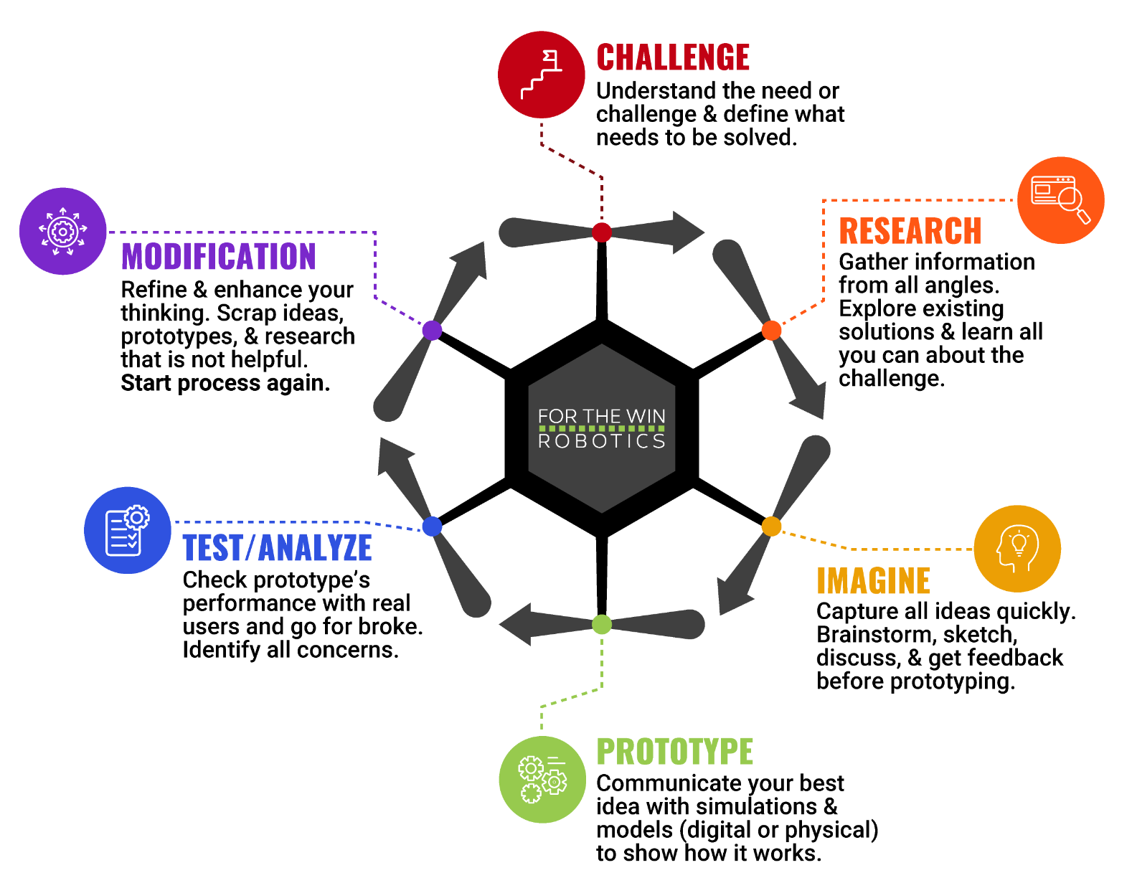
The Engineering Design Process
Let’s look at a variation of what is called the Engineering Design Process (EDP) which is a series of steps used by engineers to solve problems.

Slide 7
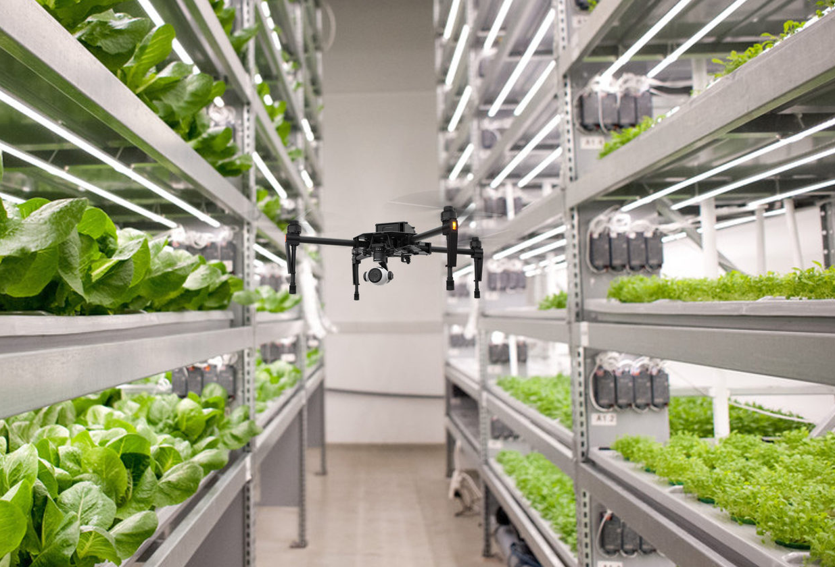
Case Study
In 2017, the Finnish company iFarm was founded to provide services for indoor and vertical farming.
According to AgFunder News, iFarm has been “experimenting with operating drones indoors to hover around, helping with inspections and data collection.”
iFarm’s chief technology says “If your farm is ten meters high, . . . it’s really a problem for all these people who observe the farm every day.”
Notes:
AgFunder News Article: https://agfundernews.com/vertical-farming-software-startup-ifarm-raises-4m
*Educators are encouraged to find case study examples local to their area.

Slide 8
Case Study − Engineering Design Process (EDP)
As a group, talk through the EDP of developing a drone used for vertical farming. Using the information given on the previous slide, how would you design the drone using the EDP?
Challenge
Research
Imagine
Prototype
Test/Analyze
Modification
Notes:
Example EDP discussion:
Challenge − Vertical farms can be unsafe and tedious for humans to monitor and tend to. A drone with a camera and data-collection sensors that can fly at a high altitude.
Research − Find information such as what sensors are currently available, quotes on the cost/timelines of creating new sensors, the maximum altitude needed, etc.
Imagine − A drone that can fly at an altitude high enough to reach the top level of the vertical farm with sensors to collect data on soil and plant health. Mock up the drone design using computer programs such as AutoCAD or other technologies.
Prototype − Find a manufacturing facility to create a prototype of the designed drone.
Test/Analyze − Test the prototype on an existing vertical farm with the desired height and evaluate its effectiveness of collecting data with its sensors.
Modification − Redesign the parts of the drone that are causing any issues.
Repeat steps as many times as needed.

Slide 9
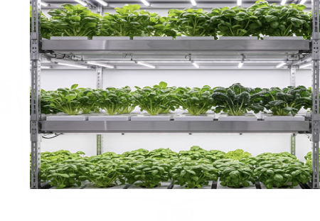
Activity Scenario
You are using Hopper to inspect three equally-spaced, vertically stacked rows of your vertical farm. Each row is 10 feet long, and each row is 2 feet apart from each other.
You will write a code to command Hopper to take off, fly across each row, and then fly down to land. Hopper’s eyes must be facing toward the rows of crops while flying horizontally to inspect.

