Slide 1


Drones in Search & Rescue
Have you ever heard of the phrase “search and rescue” and if so, do you know what it means?

Slide 2
Group Discussion Questions on Search & Rescue
Search and rescue (SAR) is the process of locating and assisting individuals who are lost or are in danger.
What are some examples of SAR?
Are there scenarios that occur in your local community that may require SAR?
Do you know of any technologies that are currently used in SAR operations?
Notes:
Example discussion topics:
Rescuing stranded hikers/climbers/skiers in mountains, locating children or elderly people in urban areas, rescuing trapped individuals after natural disasters such as floods or earthquakes, locating and rescuing individuals lost at sea, etc.
If students cannot think of scenarios in their local community, steer the discussion to where students may have seen examples of SAR when out of town or in media.
Older technologies: flares, airplanes, boats, flotation devices, etc.
Newer technologies: satellites, drones, infrared sensors, cameras, AI & AR technologies, robots, GPS, etc.

Slide 3
Types of Search & Rescue Operations
There are many types of SAR operations that depend on the location, weather, and other unique circumstances.
Some types of SAR operations include:
Ground search and rescue
Search and rescue diving
Aerial searches
Mounted (in difficult terrain) search and rescue
Vertical (at various heights) search and rescue
Flood and swiftwater rescue
Notes:
Texas Search and Rescue: https://www.texsar.org/2022/05/22/what-is-search-and-rescue-sar/

Slide 4
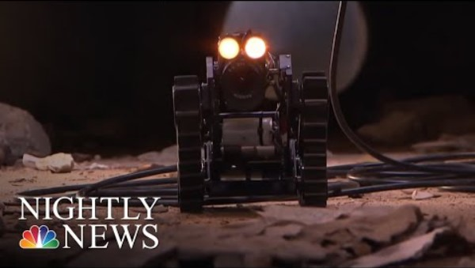
Technology in Search & Rescue
Robots, including drones, are used in SAR operations to search where it is impossible or too dangerous for humans to search.
Notes:
NBC News “Robot Rescue: Behind The Technology Deployed For Disaster Relief”
Video length − 2:11
https://www.youtube.com/watch?v=0yHjQKXWqYI

Slide 5

Parallel Track Search Pattern
Flying in a parallel track search pattern when conducting aerial searches is useful when searching a large area of land and when the location of an individual is uncertain.
This pattern consists of the aircraft flying in parallel lines, or lines that have the same distance apart at all times.

Slide 6
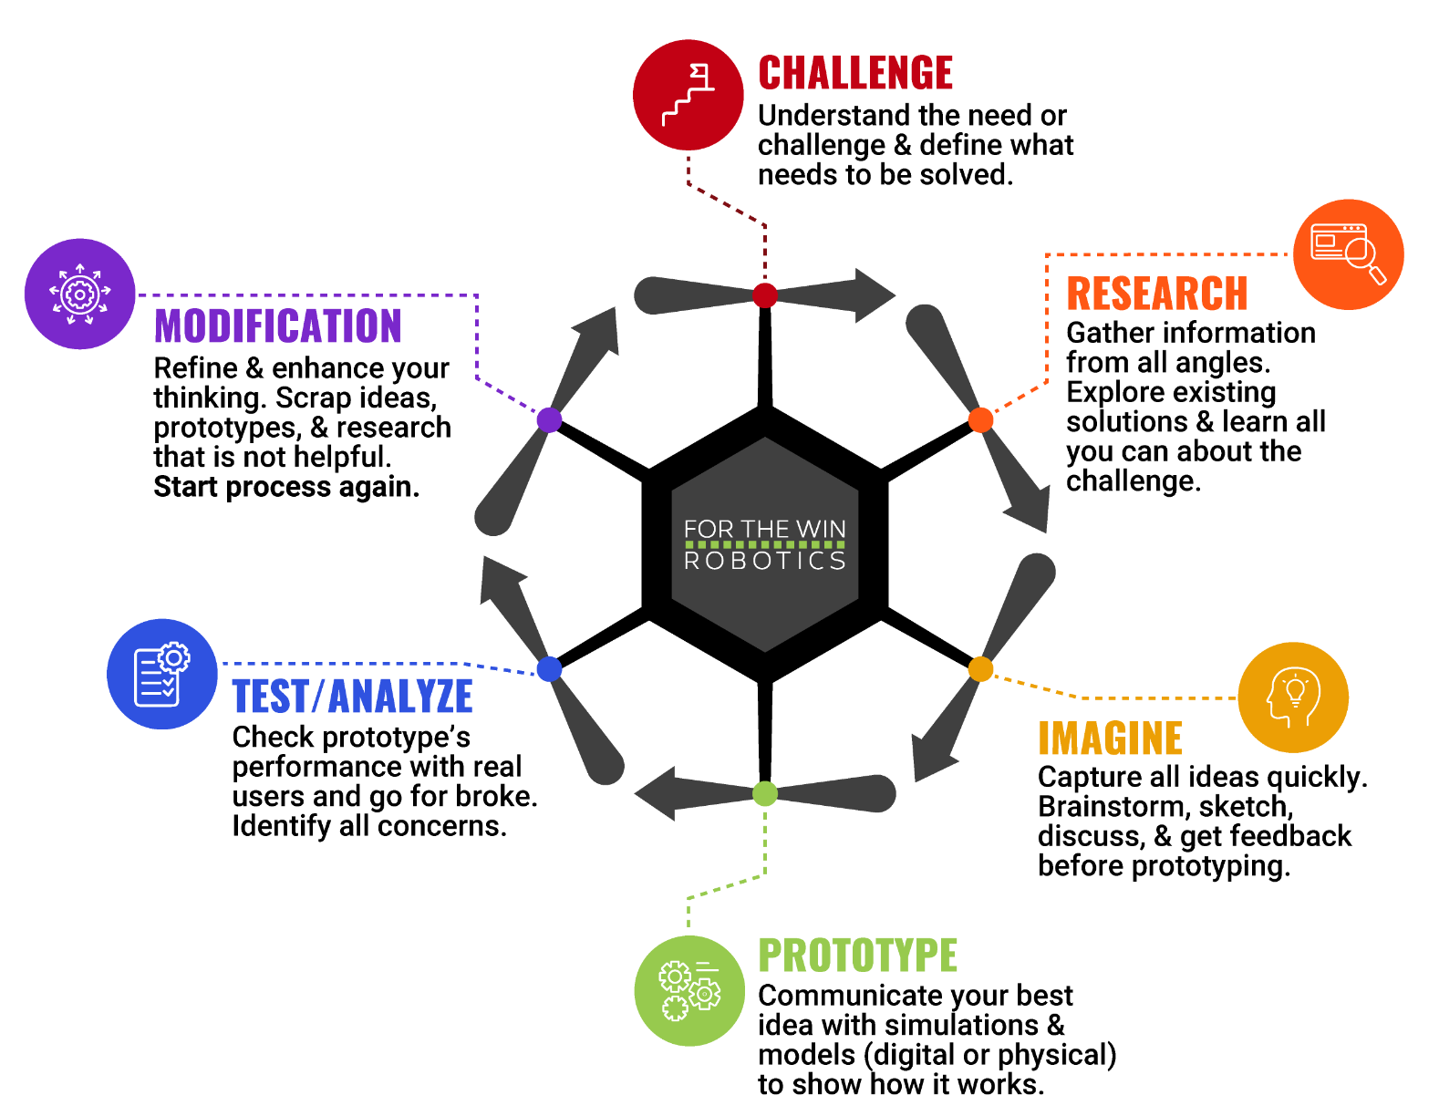
The Engineering Design Process
Let’s look at a variation of what is called the Engineering Design Process (EDP) which is a series of steps used by engineers to solve problems.

Slide 7
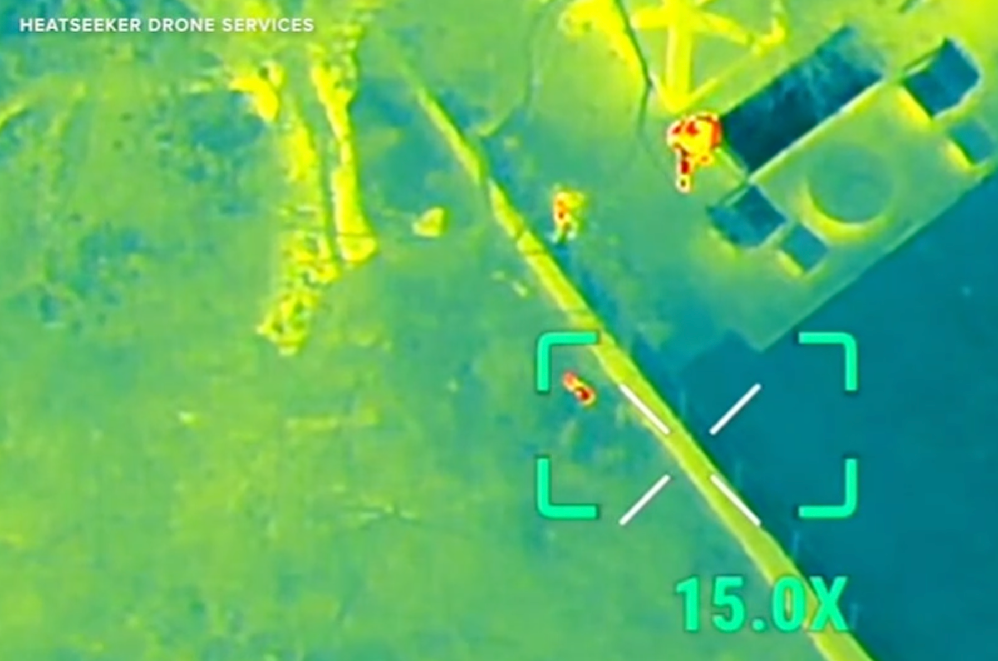
Case Study
In November 2024, a pet rescue group successfully located and rescued a dog named Lexi slipped out of her collar vanished into the woods in Dobbs Ferry, NY.
“Lexi was missing for hours but was recovered safely thanks to a view from overhead. She was tracked down with a drone equipped with thermal imaging.”
Notes:
ABC7 NY: https://abc7ny.com/post/thermal-drone-used-find-missing-puppy-woods-dobbs-ferry/15565225/
*Educators are encouraged to find case study examples local to their area. Be sensitive to events that may have had a direct negative impact on any students.

Slide 8
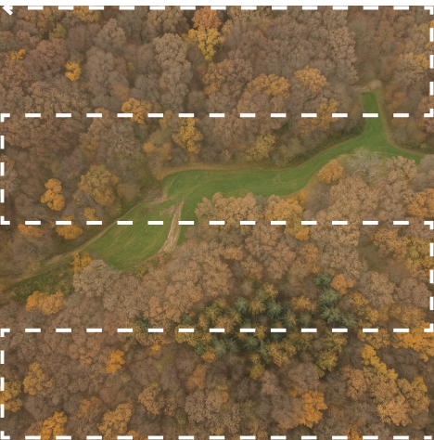
Activity Scenario
A lost dog wandered into a forest. The dog’s location is uncertain so Hopper acting as an SAR drone will fly in a parallel track search pattern during an aerial search.
You will code Hopper to fly in a parallel track search pattern in lines that are 5 feet apart.

