Slide 1


Drones in Package Delivery
How can drone delivery provide healthcare to patients?

Slide 2
Group Discussion Questions on medical Delivery
What are some examples of items that are light enough for drones to deliver related to healthcare?
What are some fields and areas of medicine that could benefit from drone delivery?
How can specifically rural and remote parts of the world benefit from drone delivery in healthcare?
Notes:
Example discussion topics:
Medications, laboratory samples, organs for transplant, vaccines, personal protective equipment (PPE), automated external defibrillator (AED), emergency blood, blood products, biosensors, etc.
Emergency medical services (EMS), telehealth, organ transplant, out of hospital cardiac arrest (OHCA), blood transfusion, surgery, rural healthcare, etc.
These places may have limited transportation options, drone delivery could be less expensive than other means of transportation, quicker delivery options, residents may have unique healthcare needs and have limited access to necessary supplies, residents could be elderly or homebound, etc.

Slide 3
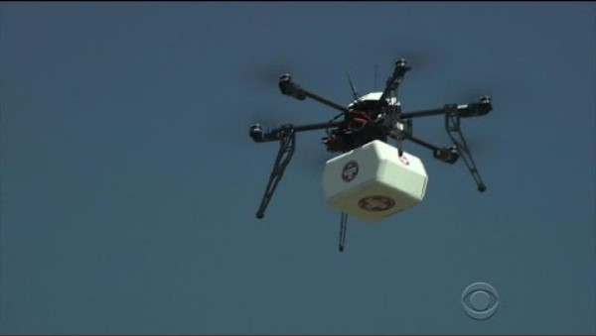
Medical Drone Delivery
In 2015, “one of the first federally approved health care-related deliveries by drone” occured in the US.
Notes:
CBS News “Drones mark first with medical delivery”
Video length − 2:05
https://www.youtube.com/watch?v=IMQHeYW8EOA

Slide 4
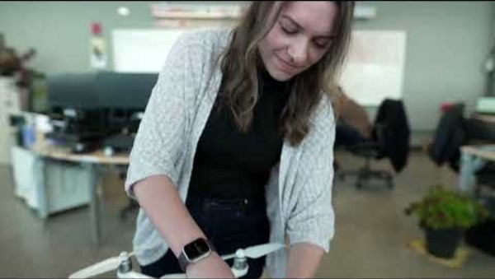
Medical Delivery to Remote Areas
Medical drone delivery is starting to be used more to provide healthcare to residents in remote and rural locations.
Notes:
Transport Canada “Drones for good: delivering medical equipment to remote communities”
Video length − 2:31
https://www.youtube.com/watch?v=odYvaZuHhJ4

Slide 5
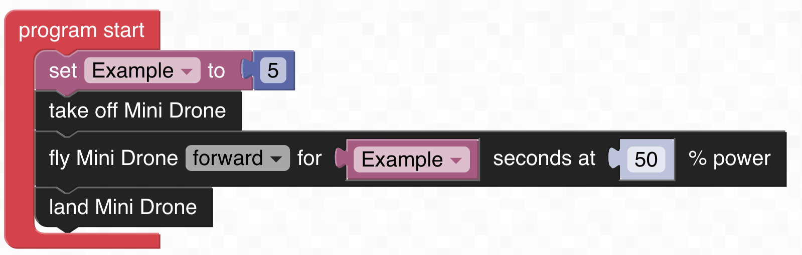
Computer Science − Variables
A variable is a place with a name that stores information.
In computer programing, a variable can be used so that a value in the code can be efficiently changed. This allows for a single code to be used with multiple pieces of information.
A variable must be declared and defined (given a value) before it is used in the code.
The variable “Example” is declared and is defined as the value 5. It is later used in the code to command Hopper to fly forward for 5 seconds at 50% power.
Notes:
FTW CODE: https://www.ftwcode.com/

Slide 6
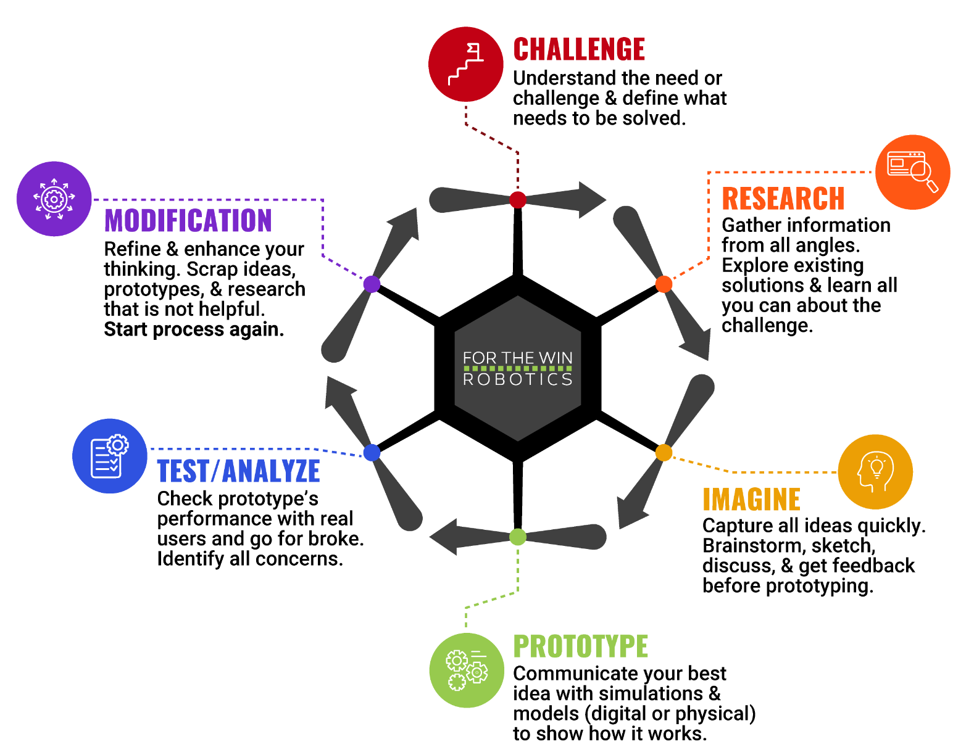
The Engineering Design Process
Let’s look at a variation of what is called the Engineering Design Process (EDP) which is a series of steps used by engineers to solve problems.

Slide 7
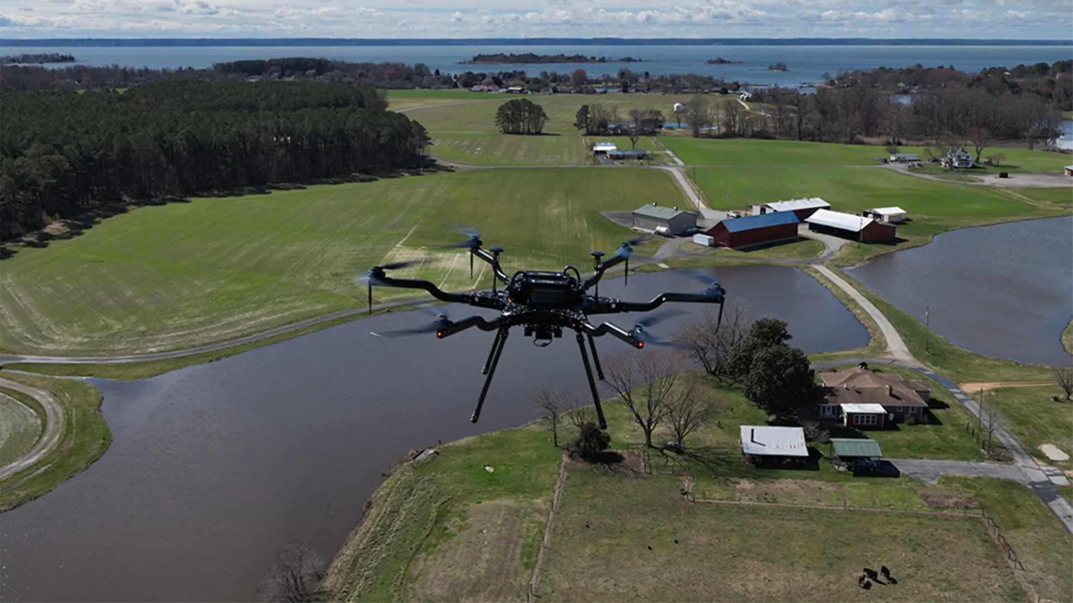
Case Study
In November 2024, the University of Maryland received a $1.76M grant from the US Department of Transportation to fund a pilot program to deliver life saving medications. One of the delivery locations is to Smith Island, a rural fishing community that lies along the Maryland-Virginia border in the Chesapeake Bay 10 miles away from the mainland.
“Many of its 200 residents are elderly or homebound and increasingly in need of medical care. The island’s lone medical assistant helps shuttle lab samples and prescriptions to and from Crisfield, the closest Eastern Shore, Md., town, via a once-daily ferry, unless winter weather blocks the passage.”
Notes:
Maryland Today – University of Maryland
“UMD to Develop Drone-Delivery Program for Patients on Rural Island” https://today.umd.edu/umd-to-develop-drone-delivery-program-for-patients-on-rural-island
*Educators are encouraged to find case study examples local to their area.

Slide 8
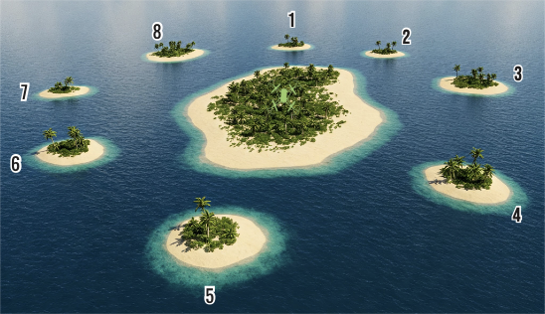
Activity Scenario
There is a medical center on an island that is surrounded by smaller islands that do not have any medical facilities. The medical center on the larger island uses Hopper to deliver time-sensitive medications to the residents of the smaller islands when there is an emergency.
Each island is equidistant (the same distance) from each other. Hopper’s starting position on the larger island is equidistant from each smaller island.
Once an emergency is called in, Hopper needs to deliver medication to that island as soon as possible. You will write a single code with a declared variable that can efficiently be defined with a value that corresponds to that island.

