Slide 1


Drones in Agriculture
What is your favorite vegetable?
Do you know how it is grown?

Slide 2
Group Discussion Questions on Agriculture
Agriculture is the practice and science of growing crops and raising livestock to provide food.
What are some examples of agriculture?
Is there any agriculture in your local community? If so, where and what is grown or raised?
Do you know of any technologies that are currently used in agriculture?
Notes:
Example discussion topics:
Farms, ranches, beekeeping, dairy farms, poultry farms, vegetable farms, aquaculture (seafood farming), etc.
If there is no agriculture in your local community, steer the discussion to where students may have seen examples of agriculture when out of town or in media.
Older technologies: tractors, automatic feeding for livestock, automatic milking, biotechnology and the development of GMOs, combines, hay balers, sprayers, etc.
Newer technologies: GPS, drones, temperature and moisture sensors, farm automation, genome editing, etc.

Slide 3
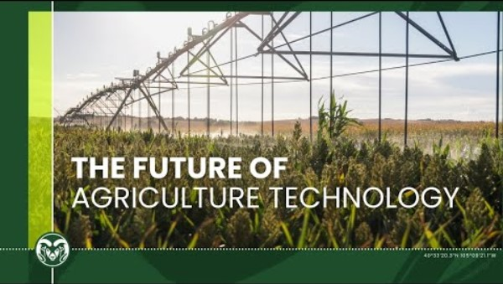
Technology in Agriculture
Notes:
Colorado State University “The Future of Agriculture Technology is Now”
Video length − 1:33
https://www.youtube.com/watch?v=Y7WX8G6enbc

Slide 4
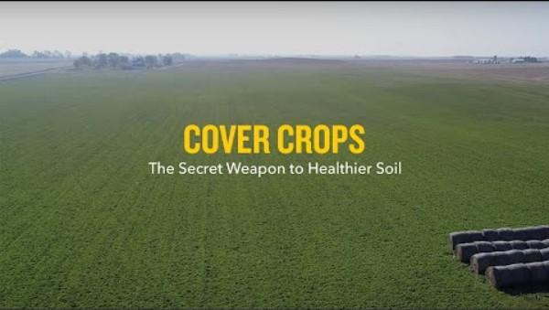
Cover Crops
A cover crop is a crop that is grown to cover and benefit the soil, not for harvesting.
Notes:
Natural Resources Defense Council “Cover Crops: The Secret Weapon to Healthier Soil”
Video length − 3:32
https://www.youtube.com/watch?v=3j5MRJeCoYs

Slide 5
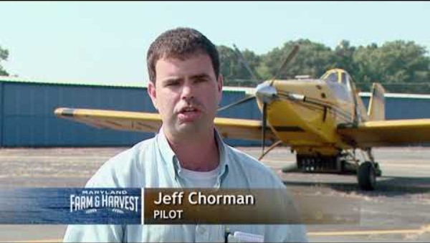
Aerial Seeding
Aerial seeding is the process of planting seeds by spraying them onto a field from a plane, helicopter, or drone.
Notes:
Maryland Farm & Harvest “Aerial Seeding”
Video length − 4:12
https://www.youtube.com/watch?v=ogawLLlg-Fw&t=1s

Slide 6
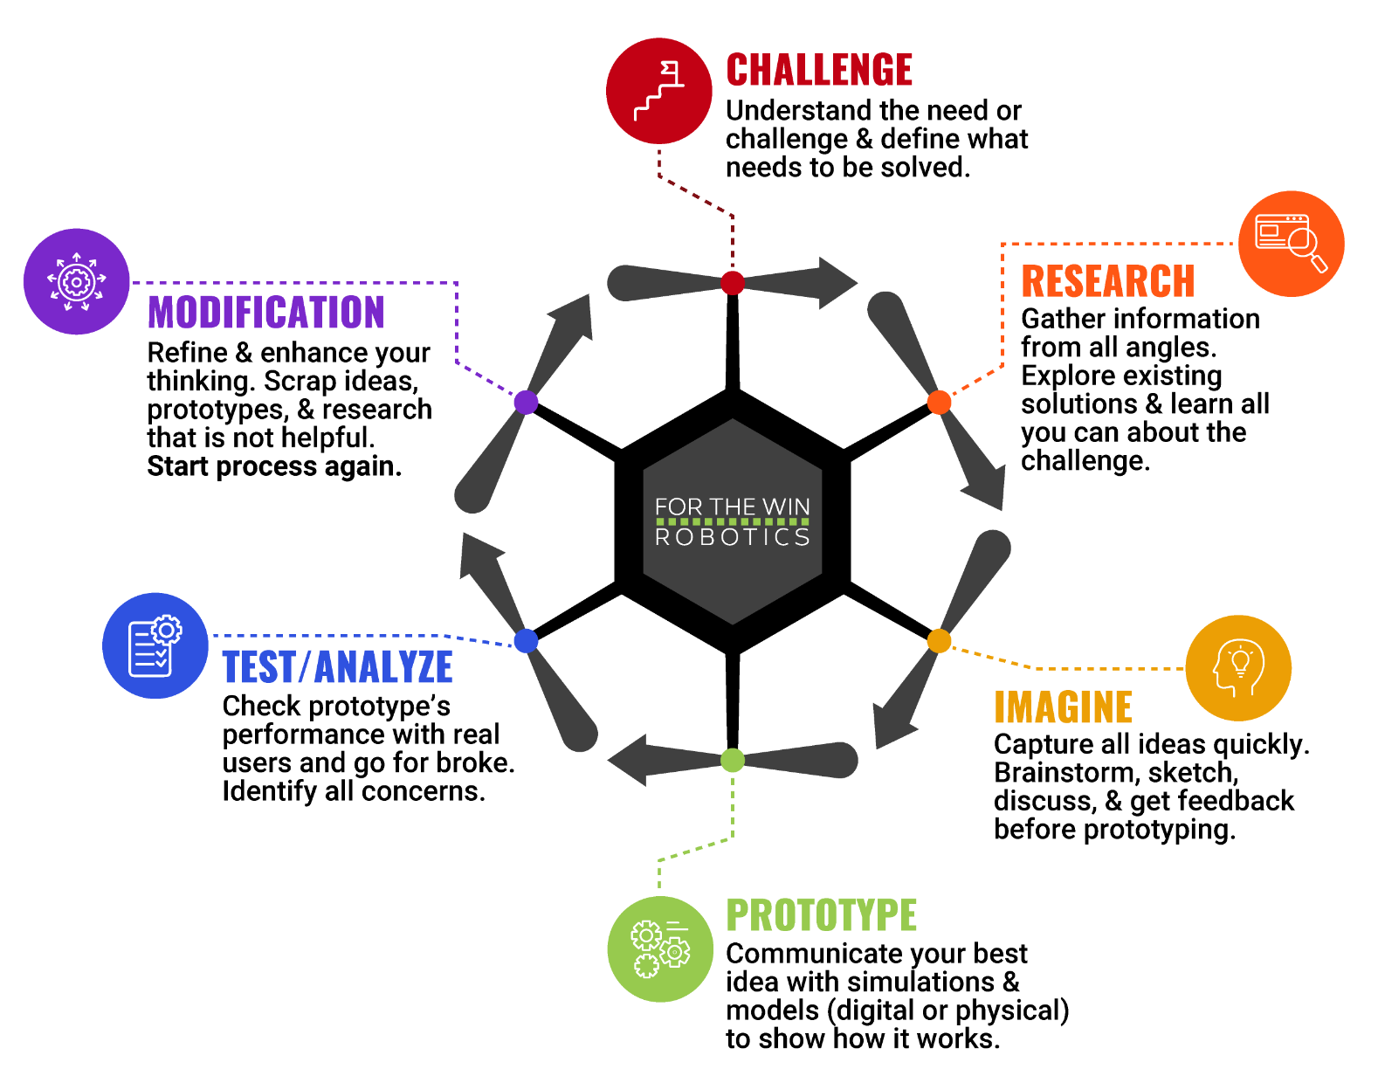
The Engineering Design Process
Let’s look at a variation of what is called the Engineering Design Process (EDP) which is a series of steps used by engineers to solve problems.

Slide 7
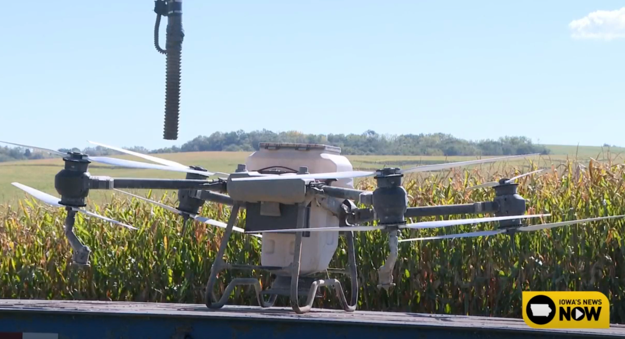
Case Study
In September 2024, a program in Dubuque County, Iowa allowed some farmers to use drones, free of cost up to 200 acres, to seed their cover crops.
“One of the big advantages of using drones, compared to traditional drilling and aerial broadcasting using planes, is that drones can apply seeds more precisely and in less time.
The goal of it is to fund programs that are tackling natural resource challenges on agricultural land, and to push for more conservation and sustainability efforts.” (Reported by CBS 2 Iowa.)
Notes:
CBS 2 Iowa News Article: https://cbs2iowa.com/news/local/free-aerial-seeding-initiative-aims-to-boost-soil-conservation-in-dubuque-county
*Educators are encouraged to find case study examples local to their area.

Slide 8
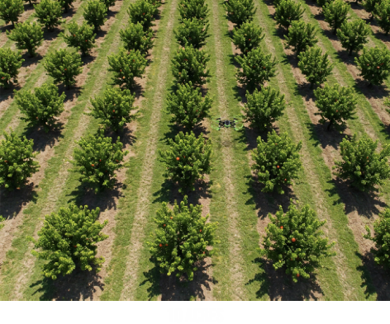
Activity Scenario
In your 10-acre peach orchard, you want to plant a grass mixture as a cover crop in between the rows of peach trees using aerial seeding with a drone.
You and a visual observer will work together to fly Hopper through the spaces between each row of trees while spraying seeds. It is necessary fill up on seeds, and to fly Hopper over and through the trees to reach the next space at the end of each row.
Then, you will find the amount of seeds needed to cover this orchard and write an equation that you can use for other orchards with different acreages to determine how much seed is needed.

