Slide 1


Drones in Construction
What types of structures need to be inspected regularly or after accidents?

Slide 2
Group Discussion Questions on site inspections
A site inspection is the process of checking that a structure or location meets specified standards.
What are some reasons that site inspections could be carried out?
What are some structures that might need to be inspected for quality and safety?
When might site inspections need to be carried out?
Notes:
Example discussion topics:
Safety, quality assurance, checking damage after a natural disaster, ensuring safe working conditions at construction sites, regulation compliance, risk management, checking construction progress, etc.
Residential buildings such as houses, power lines, bridges, skyscrapers, roads, dams, power plants, airports, railroads, hotels, warehouses, etc.
After natural disasters (such as flooding, earthquakes, wildfires, avalanches, and hurricanes), regularly scheduled checkups, before construction, during construction, after construction is completed, when permits are required, etc.

Slide 3

Construction Safety
Site inspections are carried out to ensure safety during construction. They are also carried out after accidents.
Notes:
WCPO 9 ABC News “I-Team obtains most recent inspection report for building collapse site”
Video length − 2:29
https://www.youtube.com/watch?v=3X-XcSN320w

Slide 4
Group Discussion Questions on Drones
Drones have started to be used during site inspections using the drone’s camera and sensors to collect information.
What could be some advantages of using drones during site inspections?
What could be some disadvantages of using drones during site inspections?
Notes:
Example discussion topics:
Safety for the inspectors, time efficiency, cost efficiency, able to access remote or dangerous areas, etc.
Weather can affect the flight of a drone, initial cost startup, security risks, potential accidents/crashes, regulatory restrictions, etc.

Slide 5
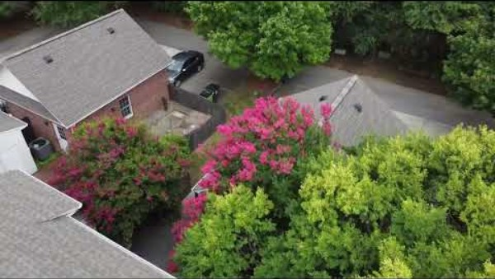
Drone inspection Process
Notes:
International Association of Certified Home Inspectors (InterNACHI) “Inspecting a Roof With a Drone”
Video length − 1:53
https://www.youtube.com/watch?v=r9RfSZwb3V0

Slide 6
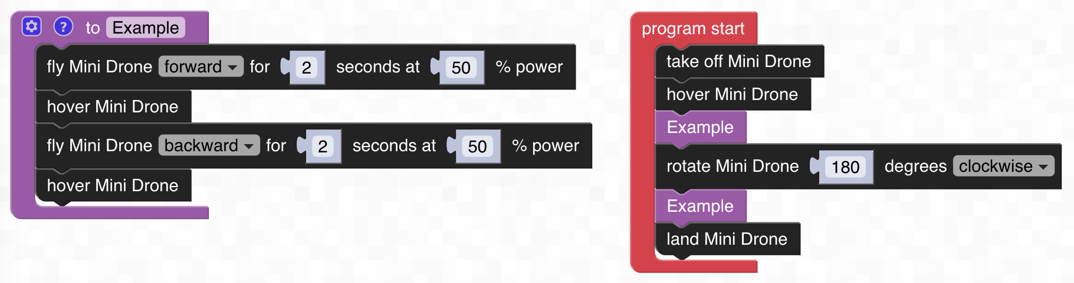
Computer Science − Functions
A function is a written block of code that can be used multiple times in the code. The function is being called whenever it is used in the code. Writing and calling a function can help keep complex more organized and manageable.
The function “Example” is called two times in the code below.
Notes:
FTW CODE: https://www.ftwcode.com/

Slide 7
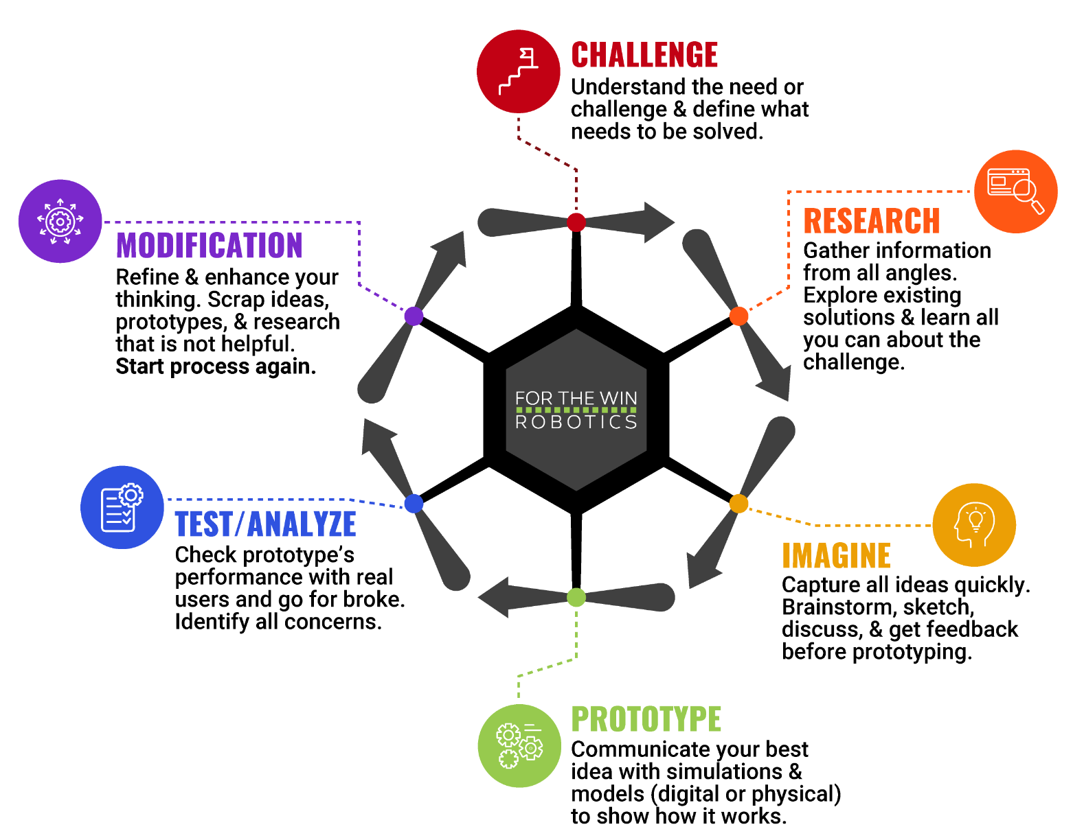
The Engineering Design Process
Let’s look at a variation of what is called the Engineering Design Process (EDP) which is a series of steps used by engineers to solve problems.

Slide 8
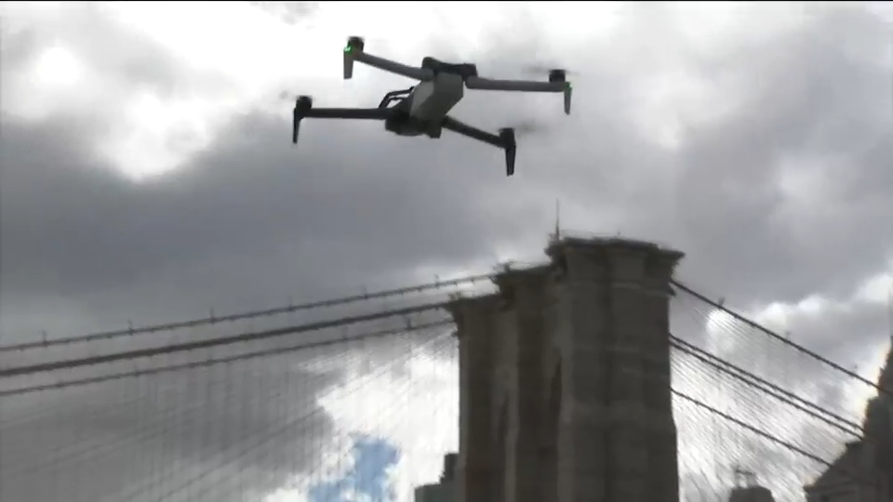
Case Study
In April 2024, the NYPD used drones to inspect bridges after a 4.8-magnitude earthquake.
“The NYPD says it generally uses drones to inspect buildings, but after Friday's earthquake, they are using them to inspect the bridges for anything that seems out of place.”
According to the NYPD Deputy Commissioner, “We are scanning the bridges up and down, looking for any type of anomalies, looking for any structural defects, looking for anything that's out of the ordinary,
Notes:
NYC Website: https://www.nyc.gov/office-of-the-mayor/news/827-24/mayor-adams-interim-police-commissioner-donlon-drone-first-responder-program-to#/0
ABC7 New York Article: https://abc7ny.com/nyc-earthquake-nypd-using-drones-to-inspect-buildings-bridges-after-48-magnitude-earthquake-in-nj/14623480/
*Educators are encouraged to find case study examples local to their area.

Slide 9
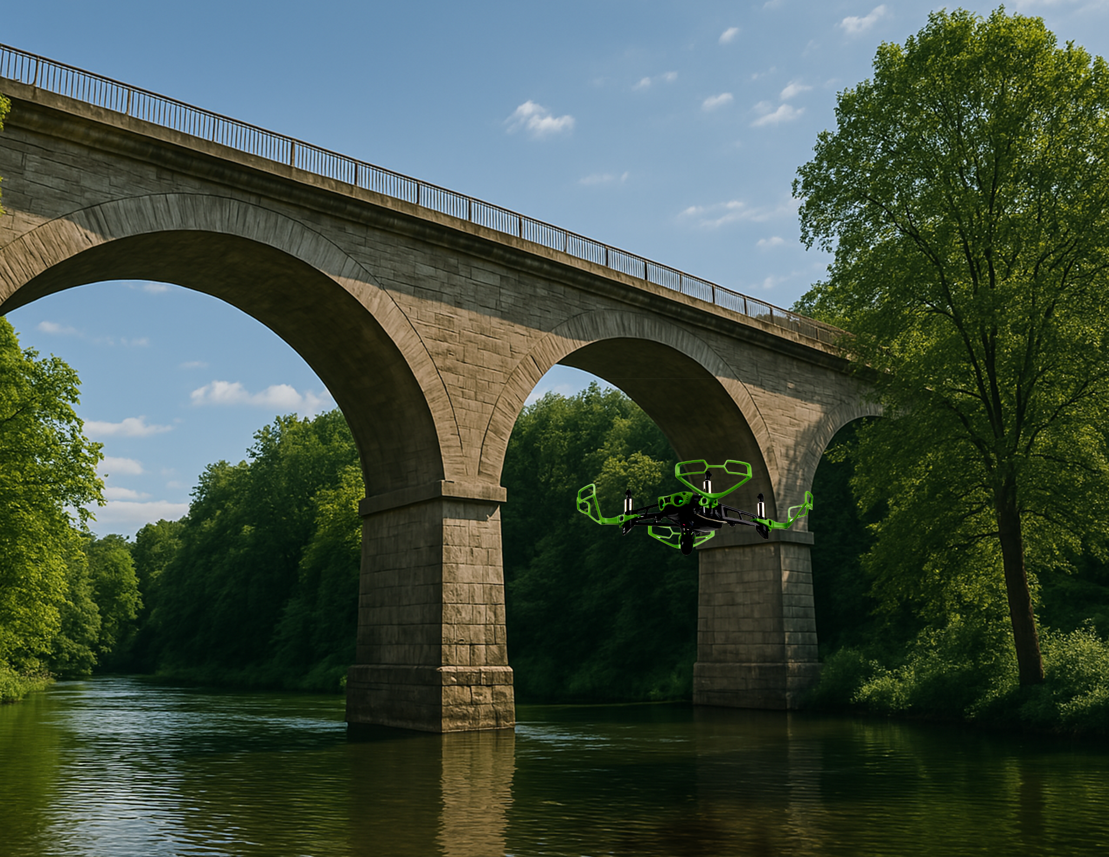
Activity Scenario
A newly built bridge is being inspected with Hopper’s camera to make note of the normal appearance of the bridge. Then after an earthquake, Hopper needs to inspect the bridge again to check for any changes to ensure that the bridge is not damaged.
You will write a code to command Hopper to fly over, under, left, and right of the bridge to identify any changes in the bridge’s structure. Hopper needs to stop and hover at three distinct points of the bridge to thoroughly inspect. You will use a function to simplify your code and stay organized.

