Slide 1


Drones in Search & Rescue
What kinds of new technologies could be created in the future of search and rescue (SAR)?

Slide 2
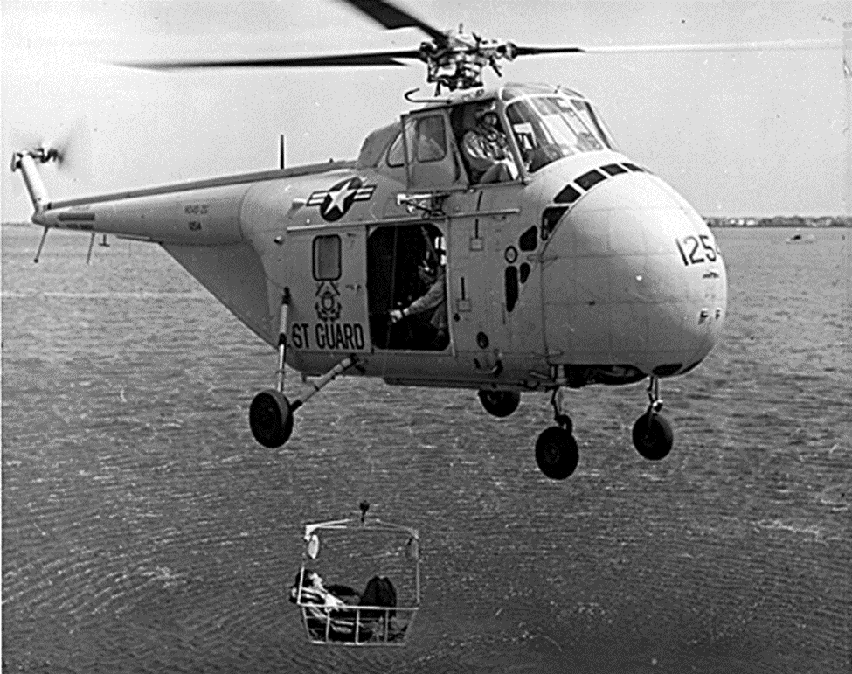
History of Aerial Search & Rescue
Helicopters were first used for search and rescue operations during World War II.
During the 1960s, Sikorsky helicopters were being developed to include bigger fuel tanks, strong hoists to pull individuals to safety, and spotlights for night SAR operations.
Technology for SAR helicopters started to include night vision and thermal imaging sensors by the 1980s.
Notes:
US Centennial of Flight Commision: https://www.centennialofflight.net/essay/Rotary/SAR/HE9.htm
US Coast Guard Aviation History: https://cgaviationhistory.org/sar/the-helicopter-in-rescue/

Slide 3
Group Discussion Questions on Search & Rescue
So far, drones have mostly been used in SAR for searching and locating individuals using cameras or sensors.
What are some future applications that drones could potentially be used in SAR?
What could be some possible obstacles and challenges when using drones for SAR in these potential future applications?
Notes:
Example discussion topics:
Artificial Intelligence, Augmented Reality, biometrics, waterproof technology, drone swarms, communication capabilities, etc.
Initial startup costs, weather conditions affecting the flight of the drone, potential for crashes, battery life, privacy concerns, etc.

Slide 4
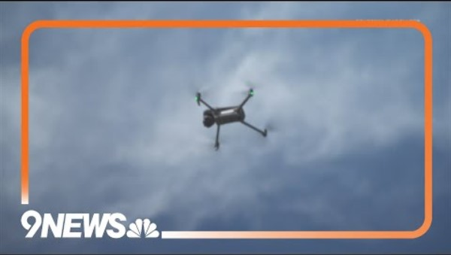
Drones in Search & Rescue
Notes:
9NEWS Denver “Crews testing AI-enabled drones for search and rescue”
Video length − 0:59
https://www.youtube.com/watch?v=Iu9G78OupDE

Slide 5

Sector Search Pattern
Flying in a sector search pattern when conducting aerial searches is useful when the search area is small and the location of an individual is accurately known.
This pattern first forms three equilateral triangles but can continue with a 30° shift.

Slide 6
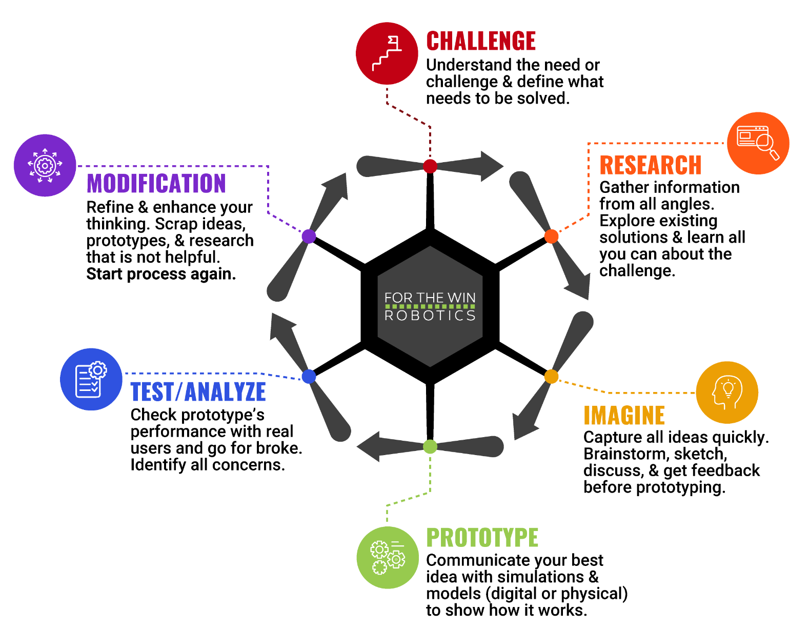
The Engineering Design Process
Let’s look at a variation of what is called the Engineering Design Process (EDP) which is a series of steps used by engineers to solve problems.

Slide 7
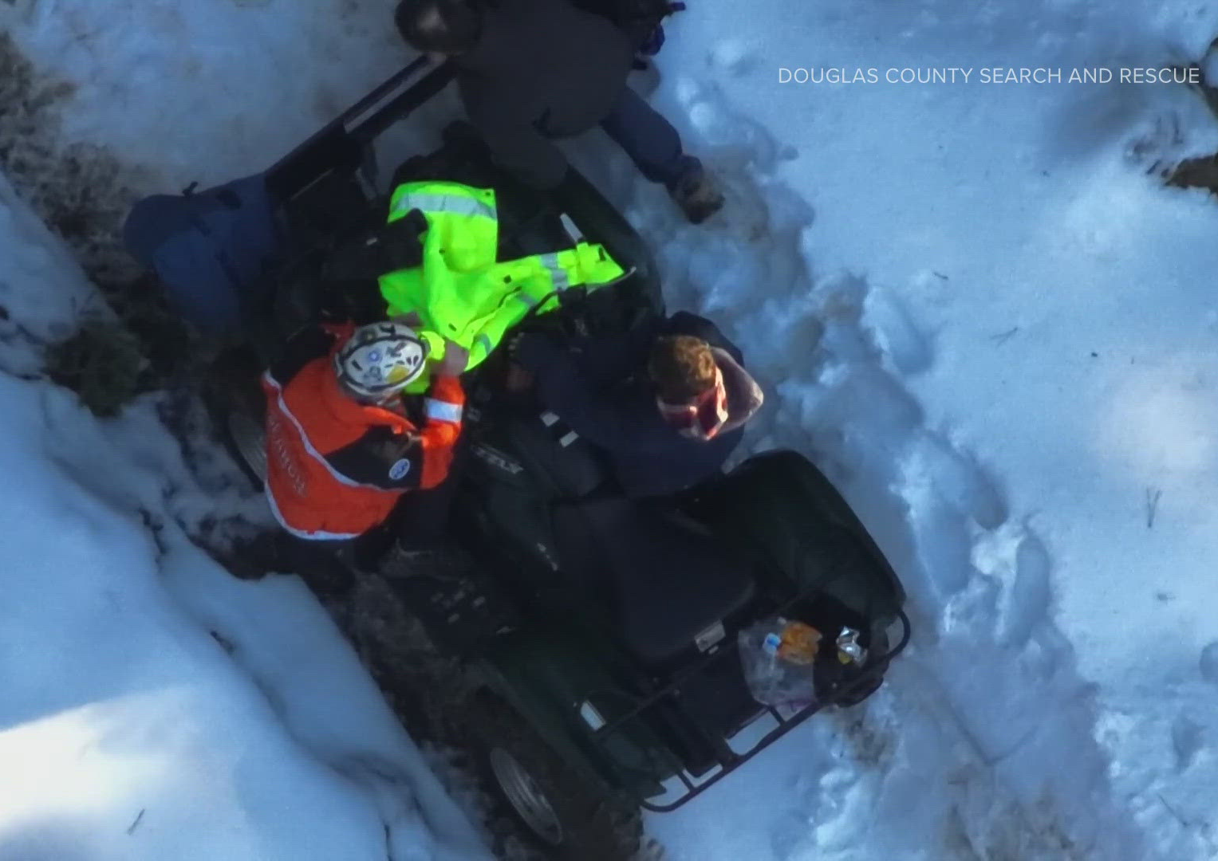
Case Study
In December 2024, a 10-year old boy went missing while riding an ATV in the snow in Douglas County, CO. After calling 911, he stayed in the same location to wait for help.
“He’d been missing for hours and found by their drone in only two minutes. Sound capabilities on the drone allowed them to communicate with the boy.
“Members of the search and rescue team loaded up a care package with food, water, a winter hat and thermal blanket to fly to the 10-year-old until rescuers could reach him.”
Notes:
9NEWS Denver: https://www.9news.com/article/news/local/boy-found-douglas-county-rescue/73-6f60fa50-f1b0-43df-b8dc-83a1229ff773
*Educators are encouraged to find case study examples local to their area. Be sensitive to events that may have had a direct negative impact on any students.

Slide 8
Case Study − Engineering Design Process (EDP)
As a group, talk through the EDP of developing the drone that located the boy in Douglas County. Using the information given on the previous slide, how would you have designed the drone using the EDP?
Challenge
Research
Imagine
Prototype
Test/Analyze
Modification

Slide 9
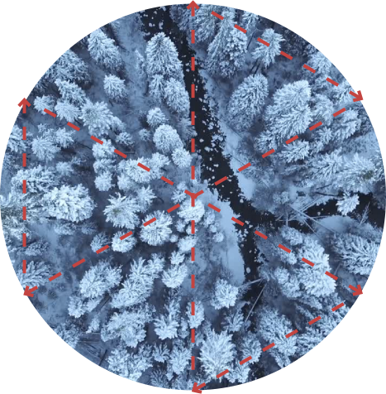
Activity Scenario
A 911 call was made by a boy who is lost in the snow. Because of his cell phone and the description given over the phone, you accurately know his location.
You will code Hopper to fly in a sector search pattern in the shape of three equilateral triangles to identify the exact location of the boy.

