Slide 1


Drones in Agriculture
What are some foods you like to eat that come from animals?

Slide 2
Group Discussion Questions on Livestock
Livestock are animals (except poultry) that are grown on farms to provide labor or produce products for consumption.
What are some examples of livestock?
What are some food products that livestock produce?
What are some non-food products that livestock produce?
Notes:
Example discussion topics:
Cows, bison, sheep, goats, pigs, horses, llamas, ostriches, etc.
Meat, milk, eggs, honey, fish, shellfish, etc.
Wool, mohair, leather, beeswax, etc.

Slide 3
How Can Drones Be Used in Livestock Management?
Monitoring herds − Drones can fly over herds of cattle to efficiently identify any issues such as potential predators, or animals straying or escaping.
Assessing health − Some drones have thermal cameras which can detect temperature changes in animals.
Managing pastures − Drones can provide aerial imaging which can recognize information such as weed infestations and grass height.

Slide 4
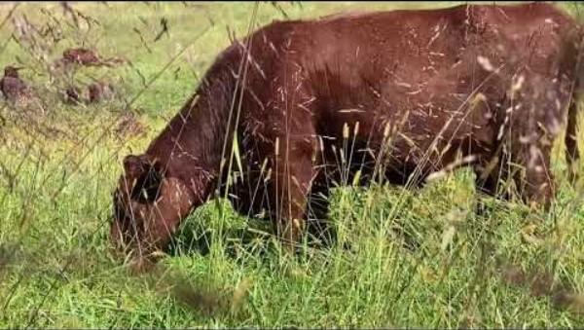
Grazing Management
Grazing is the practice of allowing animals on a farm to eat wild vegetations, such as grass.
Notes:
Chesapeake Bay Foundation “Rotational Grazing and Regenerative Agriculture: How to Make Farms Bay Friendly”
Video length − 4:16
https://www.youtube.com/watch?v=ljIzUcSwJxM

Slide 5
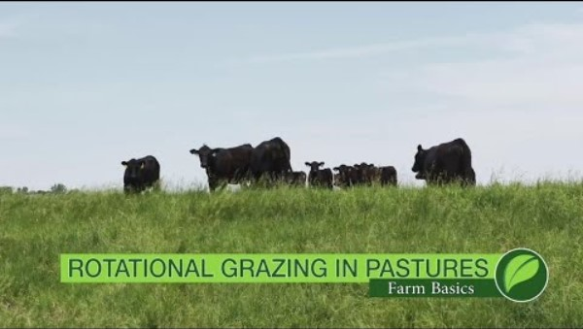
Rotational Grazing
Rotational grazing is a system where a pasture is divided into smaller sections, called paddocks, and cattle are rotated through the paddocks to allow the vegetation to regrow.
Notes:
Ag PhD “Farm Basics Rotational Grazing in Pastures”
Video length − 4:01
https://www.youtube.com/watch?v=B4GNVo2oqh4&t=1s

Slide 6
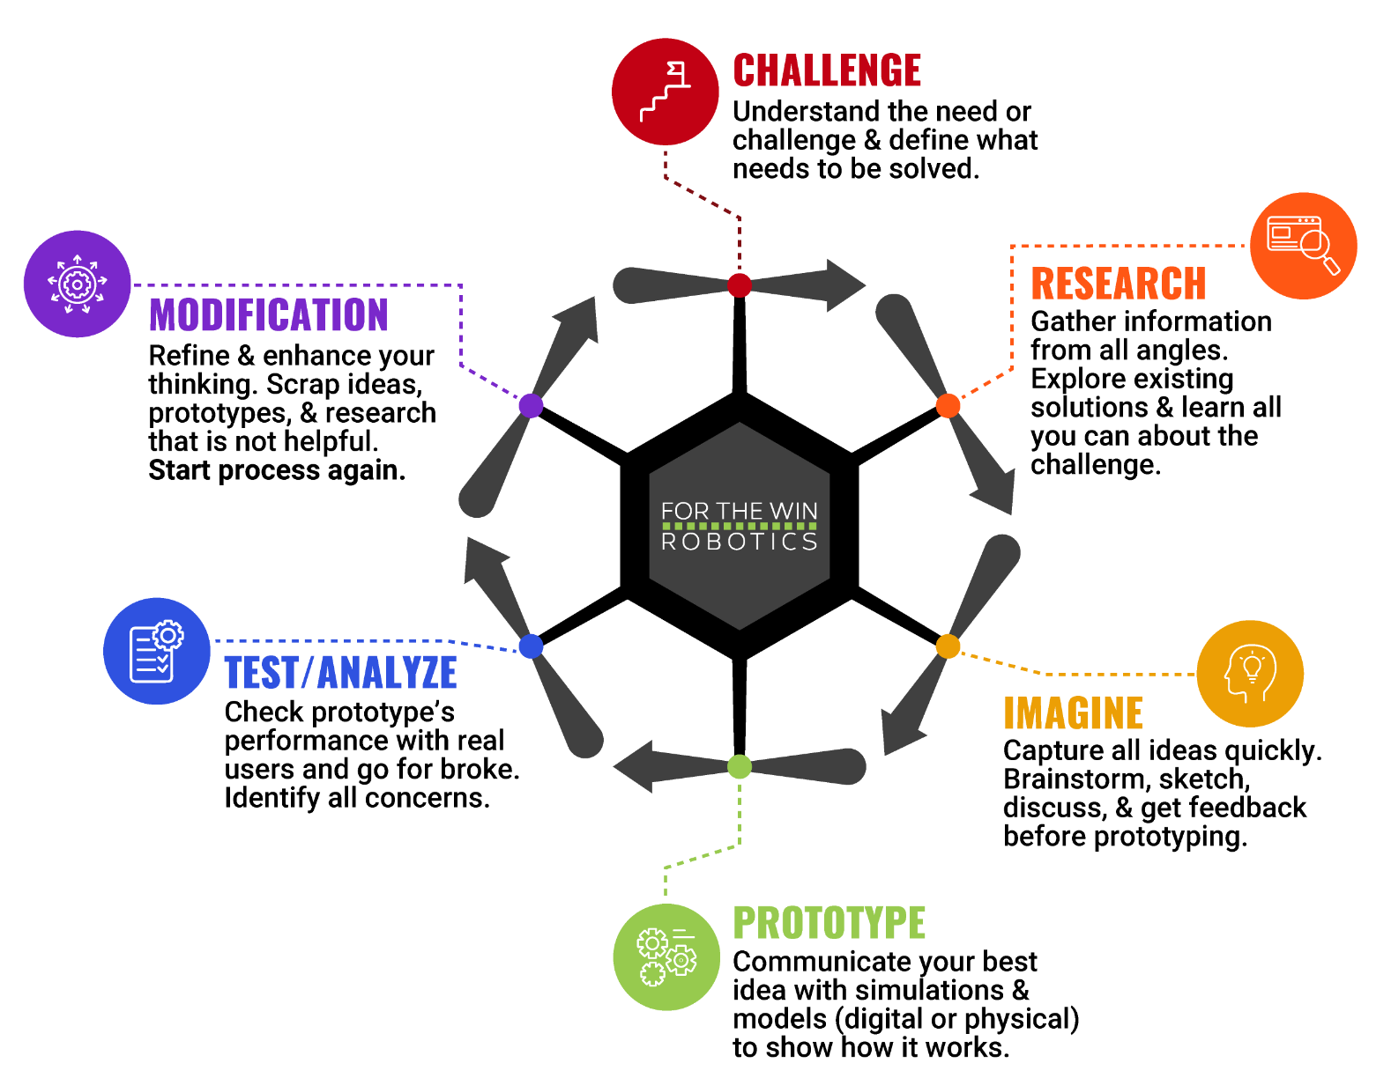
The Engineering Design Process
Let’s look at a variation of what is called the Engineering Design Process (EDP) which is a series of steps used by engineers to solve problems.

Slide 7
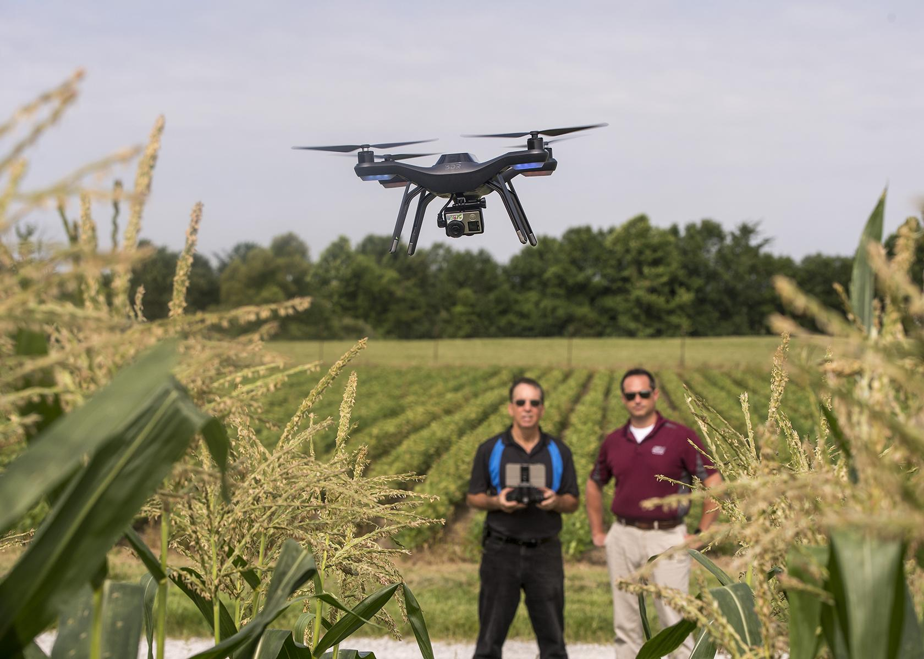
Case Study
In the fall of 2015, Southern Illinois University Carbondale began offering courses on how to use drones in farming.
“. . . most unmanned aerial vehicles intended for agricultural use are data-gatherers. . . UAVs gather information on stress-level in plants, calculate areas of weather or disease damage and help farmers predict yield.
Other applications for agriculture include assisting livestock producers by assessing forage health for grazing rotation, or measuring canopy health or tree density for foresters.” (Reported by Southern Illinois University News.)
Notes:
Southern Illinois University News Article: https://news.siu.edu/2015/07/072815amh15083.php
*Educators are encouraged to find case study examples local to their area.

Slide 8
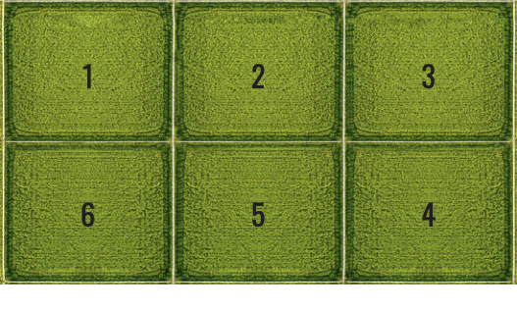
Activity Scenario
You have a 400-acre pasture of switchgrass for cattle grazing that you have separated into six equal paddocks labeled 1 through 6. You decide to use a rotational grazing system with your cattle.
You and a navigator will work together to hover Hopper over each paddock to measure the switchgrass height. Then, you will create a chart outlining your rotational grazing plan based on the recorded switchgrass heights starting at the month of April 2025.

