Slide 1


Drones in Search & Rescue
How can drones be used in search and rescue operations? What kinds of technologies could be used?

Slide 2
Group Discussion Questions on Drones
Drones are used during search and rescue (SAR) operations using the drone’s camera and thermal imaging to identify an individual’s location.
What could be some advantages of using drones during SAR operations?
What could be some disadvantages of using drones during SAR operations?
Notes:
Example discussion topics:
Able to deliver emergency supplies, time efficiency, cost efficiency, able to access remote or dangerous areas, etc.
Weather can affect the flight of a drone, initial cost startup, potential accidents/crashes, limited battery life, weight capacity a drone can hold, etc.

Slide 3
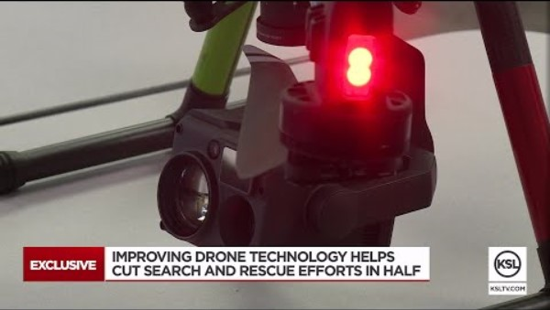
Drones in Search & Rescue
Notes:
KSL News Utah “Drones are changing search and rescue operations in Weber County”
Video length − 2:20
https://www.youtube.com/watch?v=CO2ffDH4y8E

Slide 4

Expanding Square Search Pattern
Flying in an expanding square search pattern when conducting aerial searches is useful when the general location of an individual is known.
This pattern starts where the suspected location of the individual is, and expands in a square pattern from there.

Slide 5
Group Discussion Questions on Aerial Searches
Specific aerial search patterns are selected based on the scenario.
How is the parallel track search pattern different from the expanding square search pattern?
How is a scenario when the parallel track pattern used compared to a scenario when the expanding square pattern is used?
Notes:
Example discussion topics:
Expanding square starts at the center of a search area and the parallel track starts at an end of the search area, etc.
Expanding square starts at a specific location (where the individual is suspected to be) and the parallel track starts at an end of the search area, parallel track is used to sweep over a large area and expanding square is used for a more localized search, etc.

Slide 6
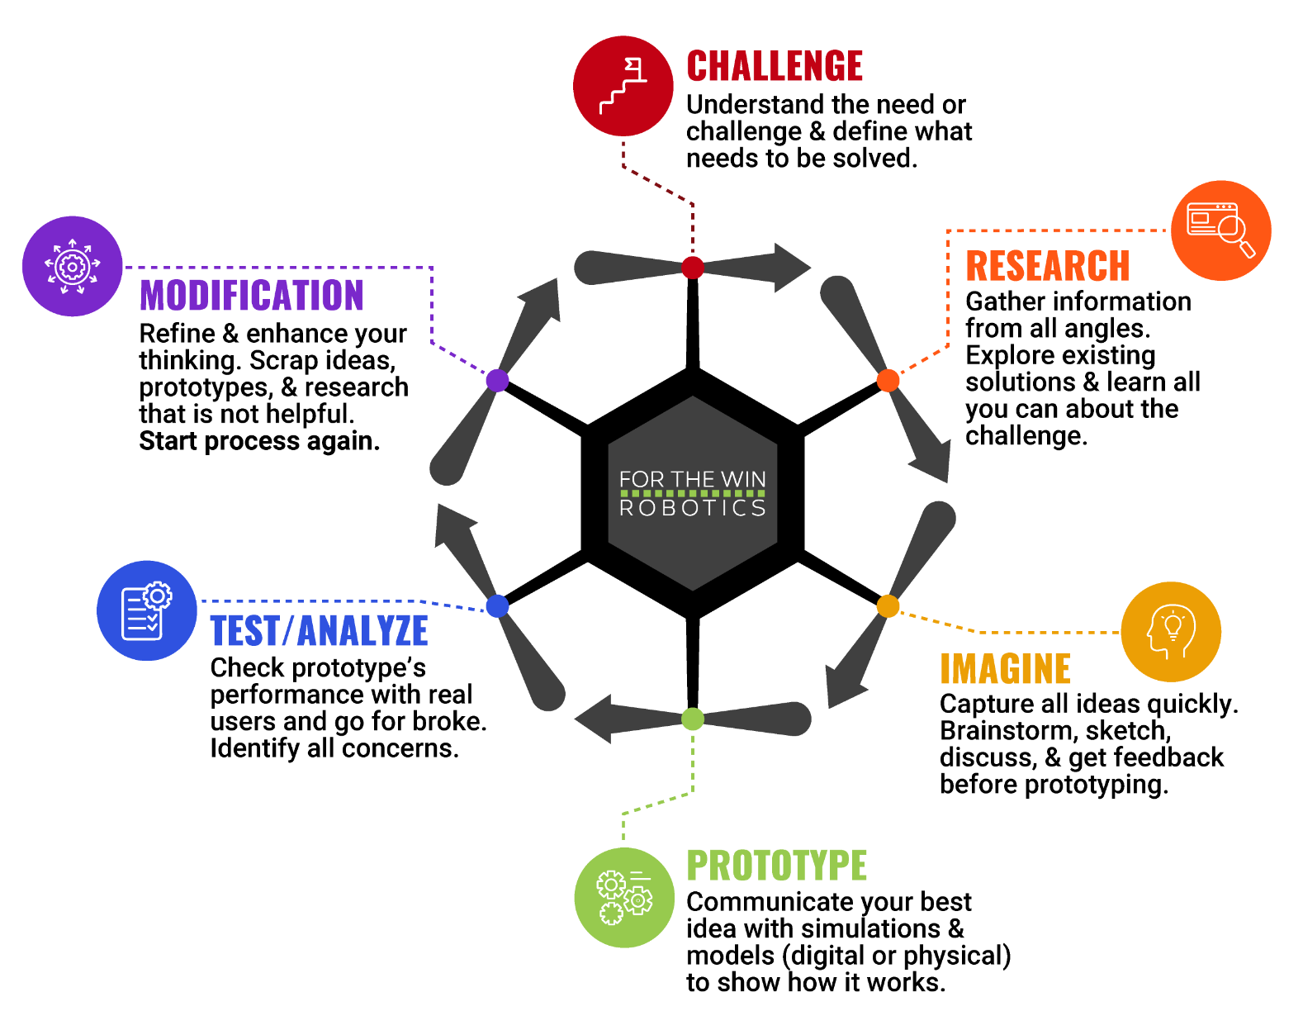
The Engineering Design Process
Let’s look at a variation of what is called the Engineering Design Process (EDP) which is a series of steps used by engineers to solve problems.

Slide 7
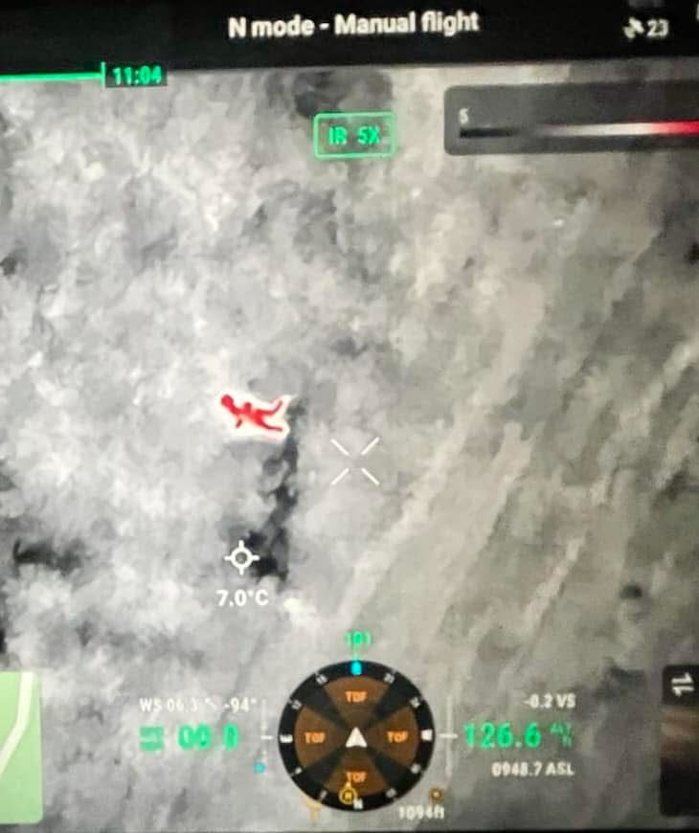
Case Study
On December 23, 2024, an elderly man with dementia went missing from his house in Malibu, CA. Malibu SAR deployed drones equipped with infrared heat seeking technology to locate the man.
“After deploying the UAS, the pilot noticed a significant heat signature over the side of the roadway in thick brush.” The man was rescued and received medical treatment.
Notes:
The Malibu Times: https://malibutimes.com/malibu-search-and-rescue-saves-elderly-man-using-a-drone-equipped-with-infrared-heat-seeking-technology
*Educators are encouraged to find case study examples local to their area. Be sensitive to events that may have had a direct negative impact on any students.

Slide 8
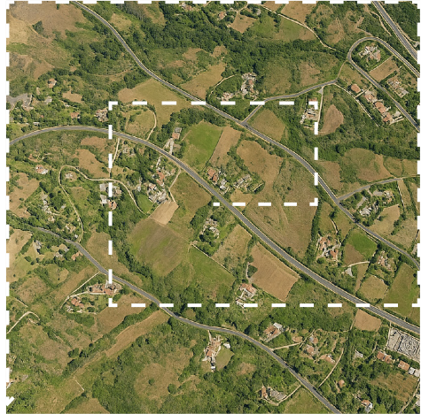
Activity Scenario
An elderly man with dementia left his home and did not return. Search and rescue responders will use Hopper to conduct an aerial search of the area around his home.
You will code Hopper to fly in an expanding square search pattern starting with initial sides starting at 5 feet apart. The start of the pattern will be at the man’s home since he cannot walk very far.

