Slide 1


Drones in Package Delivery
Have you heard about drone delivery services? What items do they deliver?

Slide 2
Group Discussion Questions on Drone Delivery
Delivery drones are used to transport lightweight goods short distances.
What are some examples of items that drones could deliver?
What are some technologies that delivery drones might need?
What could be some advantages of using delivery drones? What could be some disadvantages?
Notes:
Example discussion topics:
Letters, small packages, food, groceries, medicine, other medical supplies, etc.
GPS, long-lasting battery, camera, sensors to detect obstacles [such as ultrasonic or light detection and ranging (LiDAR) sensors], infrared sensors, etc.
Advantages: shorter delivery time, can use less energy than a vehicle or airplane, less costly over time, can access more remote locations easier than other transportation, etc.
Disadvantages: high upfront costs, drones are more sensitive to wind and precipitation than vehicles and airplanes, privacy concerns about drones with cameras, low weight limit, subject to strict laws and regulations, safety concerns about possible collisions, noise concerns, etc.

Slide 3
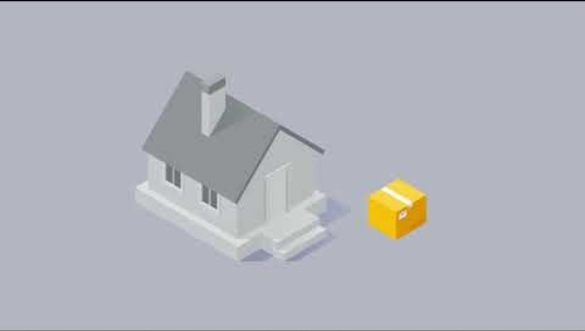
How does Drone Package Delivery work?
Notes:
Federal Aviation Administration (FAA) “Drone Package Delivery and How It Works”
Video length − 1:14
https://www.youtube.com/watch?v=j-rSXIPqRw0

Slide 4
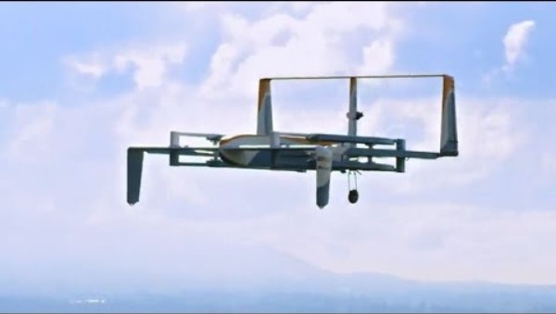
Drone Package Delivery
Amazon made its first drone delivery in 2016 in the UK.
Notes:
CNET “Amazon makes its first drone delivery”
Video length − 0:56
https://www.youtube.com/watch?v=0RWzVj3Y3C4

Slide 5
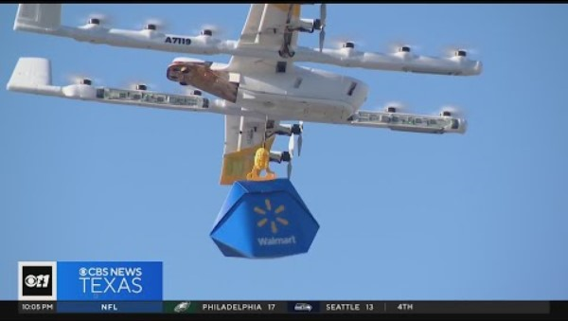
Drone Package Delivery
A lot businesses are starting to use drones to deliver packages of goods bought online.
Notes:
CBS Texas “Walmart expands drone delivery services to Lewisville”
Video length − 2:11
https://www.youtube.com/watch?v=UkYh0nlQdPA

Slide 6
Drone Delivery − Visual Line of Sight
Visual line of sight (VLOS) refers to the ability of the remote pilot in command (RPIC) to see their drone at all times during flight.
The Federal Aviation Administration (FAA) requires RPICs of recreational and commercial drones to maintain VLOS under Part 107 (drone certification) rules.
A waiver administered by the FAA is required to fly a drone beyond visual line of sight (BVLOS), or when the RPIC cannot see the drone during flight.
Notes:
Part 107 VLOS Regulation: https://www.ecfr.gov/current/title-14/chapter-I/subchapter-F/part-107#107.31

Slide 7
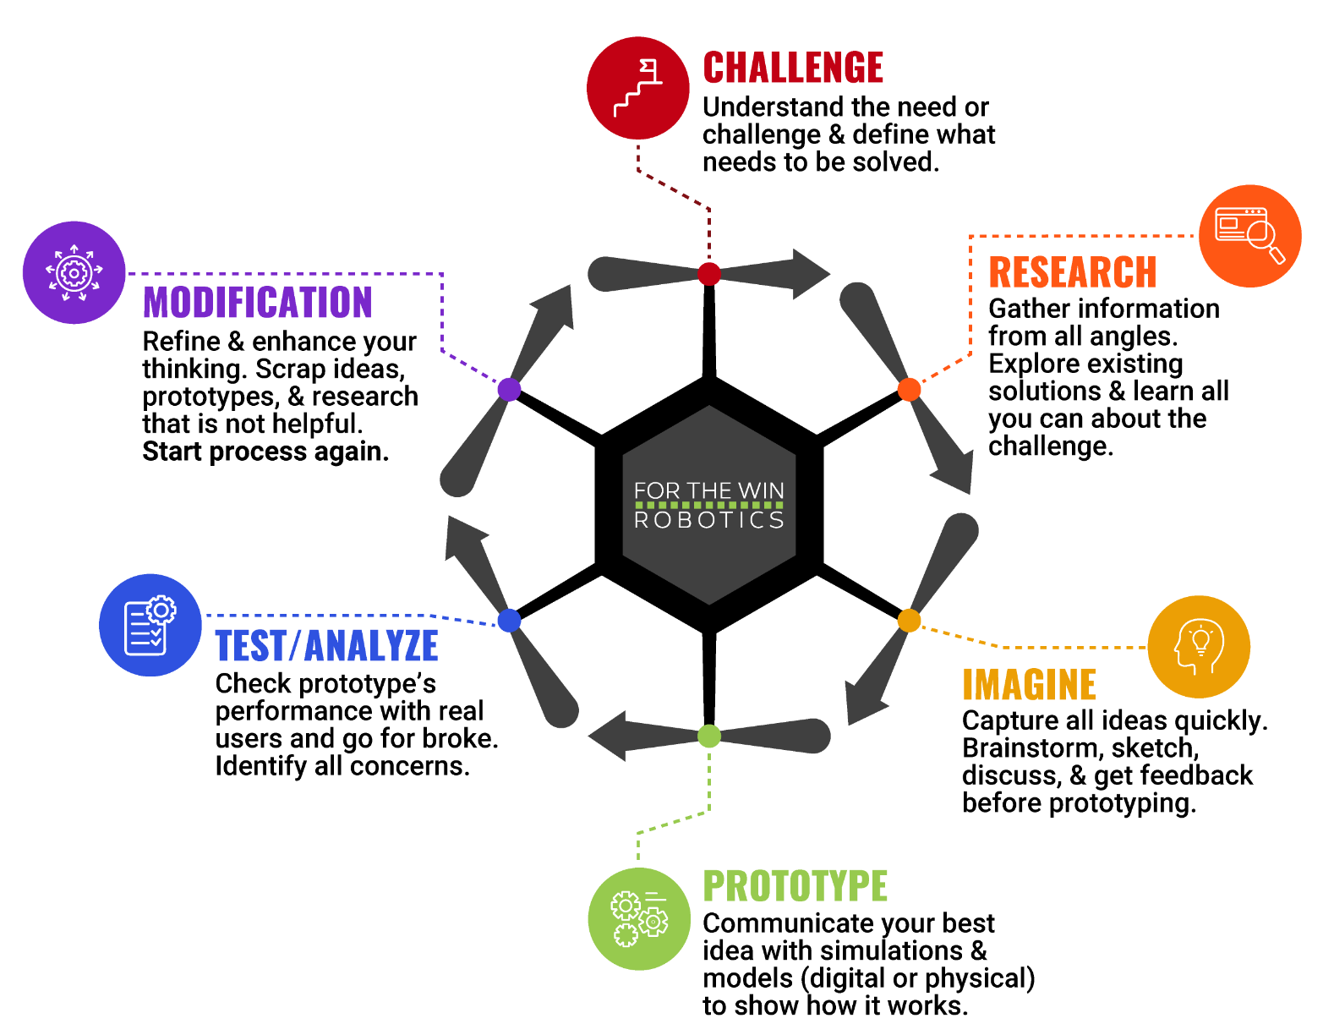
The Engineering Design Process
Let’s look at a variation of what is called the Engineering Design Process (EDP) which is a series of steps used by engineers to solve problems.

Slide 8
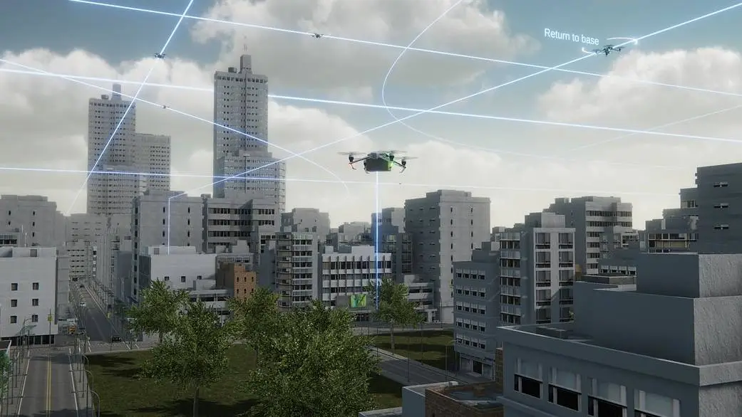
Case Study
In July 2024, the FAA authorized several American companies to fly commercial drones in the same airspace beyond visual line of sight (BVLOS), or when the pilot cannot see the drone.
“...NASA developed several key technologies, most notably Unmanned Aircraft System (UAS) Traffic Management (UTM), which allows for digital sharing of each drone user’s planned flight details.
According to Parimal Kopardekar, NASA’s Advanced Air Mobility mission integration manager, “This technology is now adopted globally as the key to enabling Beyond Visual Line of Sight drone operations.”
Notes:
National Aeronautics and Space Administration (NASA)
“NASA Moves Drone Package Delivery Industry Closer to Reality” https://www.nasa.gov/aeronautics/delivering-closer-to-reality/
“Learn More About NASA’s UTM BVLOS Subproject” https://www.nasa.gov/directorates/armd/aosp/armd-aosp-atm-x/utm-bvlos/about-utm-bvlos/
*Educators are encouraged to find case study examples local to their area.

Slide 9
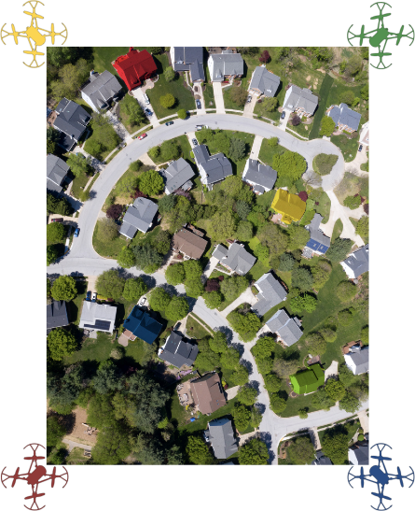
Activity Scenario
Four separate companies receive online orders for drone delivery simultaneously. The companies must communicate with each other before making deliveries to their customers homes to ensure safety and accuracy.
The delivery Hoppers will be beyond visual line of sight (BVLOS) so each RPIC will work with a navigator who will have access to Hopper’s camera during the delivery. After the delivery has been made, each RPIC and navigator will need to get Hopper back to their takeoff location.

