Slide 1


Drones in Package Delivery
What kinds of new technologies could be created in the future of drone delivery?

Slide 2
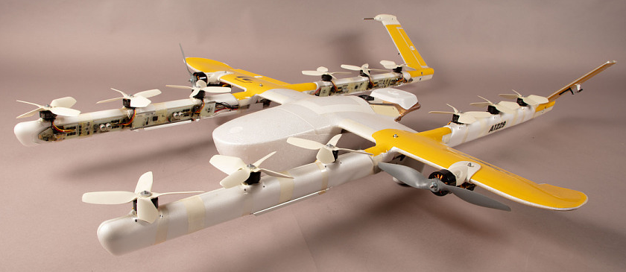
History of Commercial Drone Delivery
Google and Amazon were some of the first American companies to develop drones for commercial delivery in the United States.
The National Air and Space Museum houses the Wing M7000 drone which on October 18, 2019 in Christiansburg, Virginia “made the first Federal Aviation Administration approved aerial drone home delivery service in the United States.”
Notes:
National Air and Space Museum: https://airandspace.si.edu/collection-objects/delivery-drone-wing-m7000/nasm_A20200480000
Additional article
CBS News: https://www.cbsnews.com/news/dhl-testing-delivery-drones/

Slide 3
Group Discussion Questions on the
Future of drone delivery
Commercial drone delivery is relatively new, only beginning in the 2010s.
What could be some concerns from the public as commercial drone delivery becomes more widely available?
What kinds of technologies could improve the performance of delivery drones?
Notes:
Example discussion topics:
Noise complaints, privacy concerns, safety concerns, delivery accuracy, vandals, thieves, etc.
Quieter motors and rotors, increased battery life, more accurate GPS systems, improved traffic management systems, ability to carry heavier items, sensors to fly at night, ways to increase flight speed, etc.

Slide 4
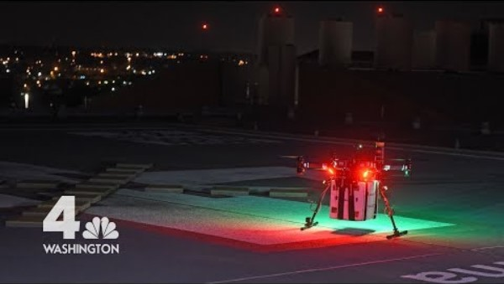
The Future of Medical Drone Delivery
Organ delivery by drone for transplant patients is currently in its early stages.
Notes:
NBC4 Washington “Historic Drone Flight Set to Revolutionize Organ Transplants”
Video length − 2:13
https://www.youtube.com/watch?v=f_n6WvRH59M

Slide 5
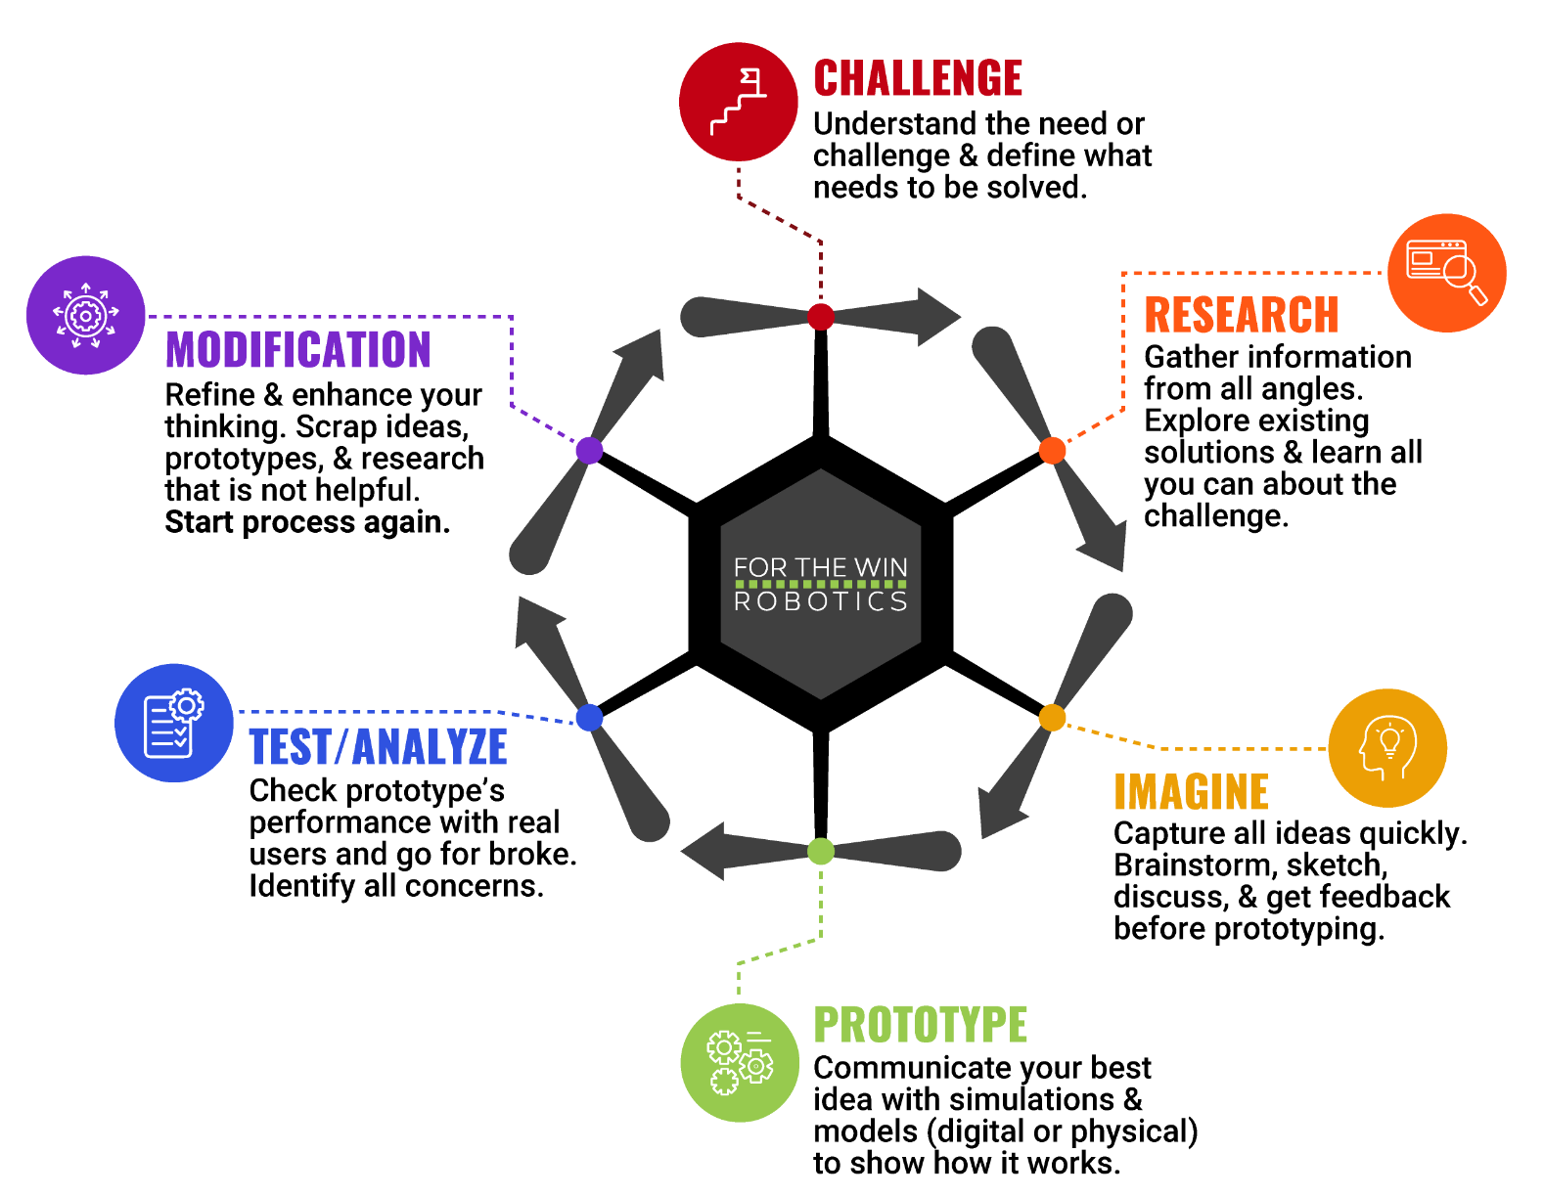
The Engineering Design Process
Let’s look at a variation of what is called the Engineering Design Process (EDP) which is a series of steps used by engineers to solve problems.

Slide 6
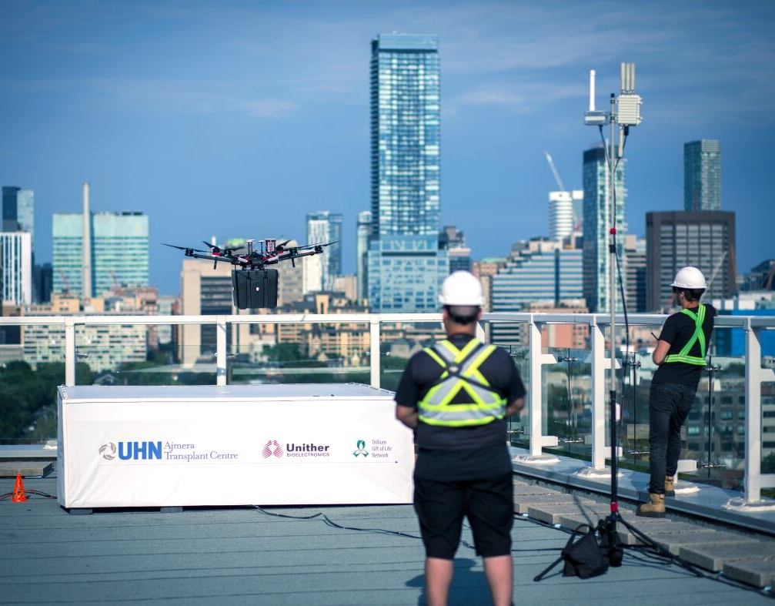
Case Study
In 2021, a Canadian man in Toronto became the first transplant patient to receive a pair of lungs delivered by a drone. The journey took a total of 6 minutes from one hospital in the city to another.
“Flying a drone in this city is [challenging], because it's a populated area with a lot of radio frequency interference and also [lots of] people around.”
A total of 53 test flights between these two hospitals were conducted to develop a reliable navigation system.
Notes:
Canadian Broadcasting Corporation (CBC) Article: https://www.cbc.ca/news/canada/toronto/drone-lung-delivery-toronto-1.6209330

Slide 7
Case Study − Engineering Design Process (EDP)
As a group, talk through the EDP of developing the navigation system used to deliver the lungs by drone. Using the information given on the previous slide, how would you have designed the system using the EDP?
Challenge
Research
Imagine
Prototype
Test/Analyze
Modification
Notes:
Example EDP discussion:
Challenge − Safely delivering lungs from one hospital to another across a busy and crowded city.
Research − Find information such as the maximum weight the drone can carry, battery life for the drone, which areas of the city have a lot of radio frequency that could cause interference, local regulations on flying UAVs, etc.
Imagine − A drone that has safety measures in case of drone failure to protect the organ being delivered along with a reliable navigation system. Mock up the drone design using computer programs such as AutoCAD or other technologies.
Prototype − Design a draft of the navigation system.
Test/Analyze − Test the navigation system with practice flights.
Modification − Redesign the pieces of the navigation system that are causing any issues.
Repeat steps as many times as needed.

Slide 8
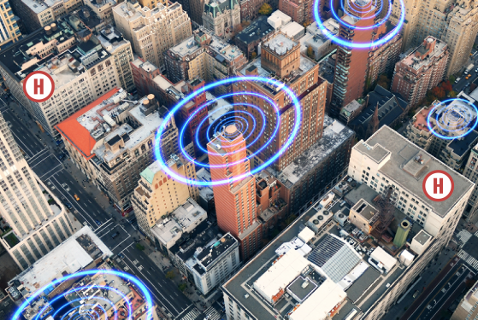
Activity Scenario
A hospital that accepts lung transplant patients wants to come up with a code to program Hopper to deliver lungs from another hospital that is located across a densely populated city.
During delivery, Hopper must avoid areas with high chances of radio frequency to avoid signal interference between Hopper and the operator, and high rise buildings that are not allowed to be flown over to comply with local ordinances.

