Slide 1


Drones in Construction
What kinds of new technologies could be created in the future of construction?

Slide 2
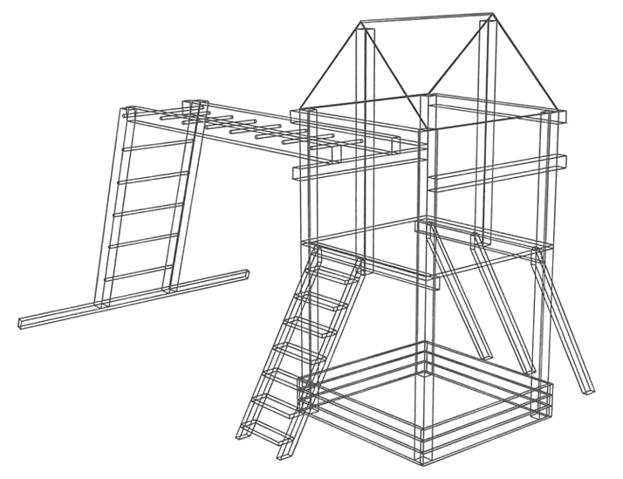
History of Construction technology
Computers were starting to be used in construction during the 1950s with Computer Aided Design (CAD). Before computers, designs were either drawn or created as a 3D model. Using CAD software was more accurate and efficient for designers.
Up until the 1970s, construction equipment was continuing to get bigger. Lighter equipment with more operational abilities was beginning to be produced which allowed for greater efficiency, an increase in safety, lower costs, and reduced emissions.
Notes:
BBC Bitesize Article: https://www.bbc.co.uk/bitesize/articles/z6kgdnb#z293dnb
American Society of Civil Engineers Article: https://ascelibrary.org/doi/10.1061/%28ASCE%29CO.1943-7862.0000374

Slide 3
Group Discussion Questions on Construction
So far, drones have mostly been used in construction for monitoring, inspecting, land surveying, and some data collection.
What are some future applications that drones could potentially be used in construction?
What could be some possible obstacles and challenges when using drones for construction in these potential future applications?
Notes:
Example discussion topics:
3D printing, delivering building materials, performing tasks previously done by humans such as pouring concrete, etc.
Initial startup costs, security threats, regulations on flying drones in certain areas, weather conditions affecting the flight of the drone, potential for crashes, etc.

Slide 4
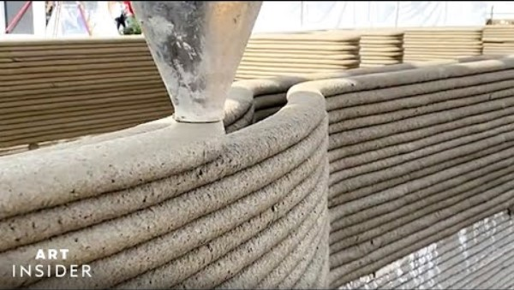
3D Printing in Construction
Notes:
Insider Art “How Concrete Homes Are Built With A 3D Printer”
Video length − 5:32
https://www.youtube.com/watch?v=vL2KoMNzGTo

Slide 5
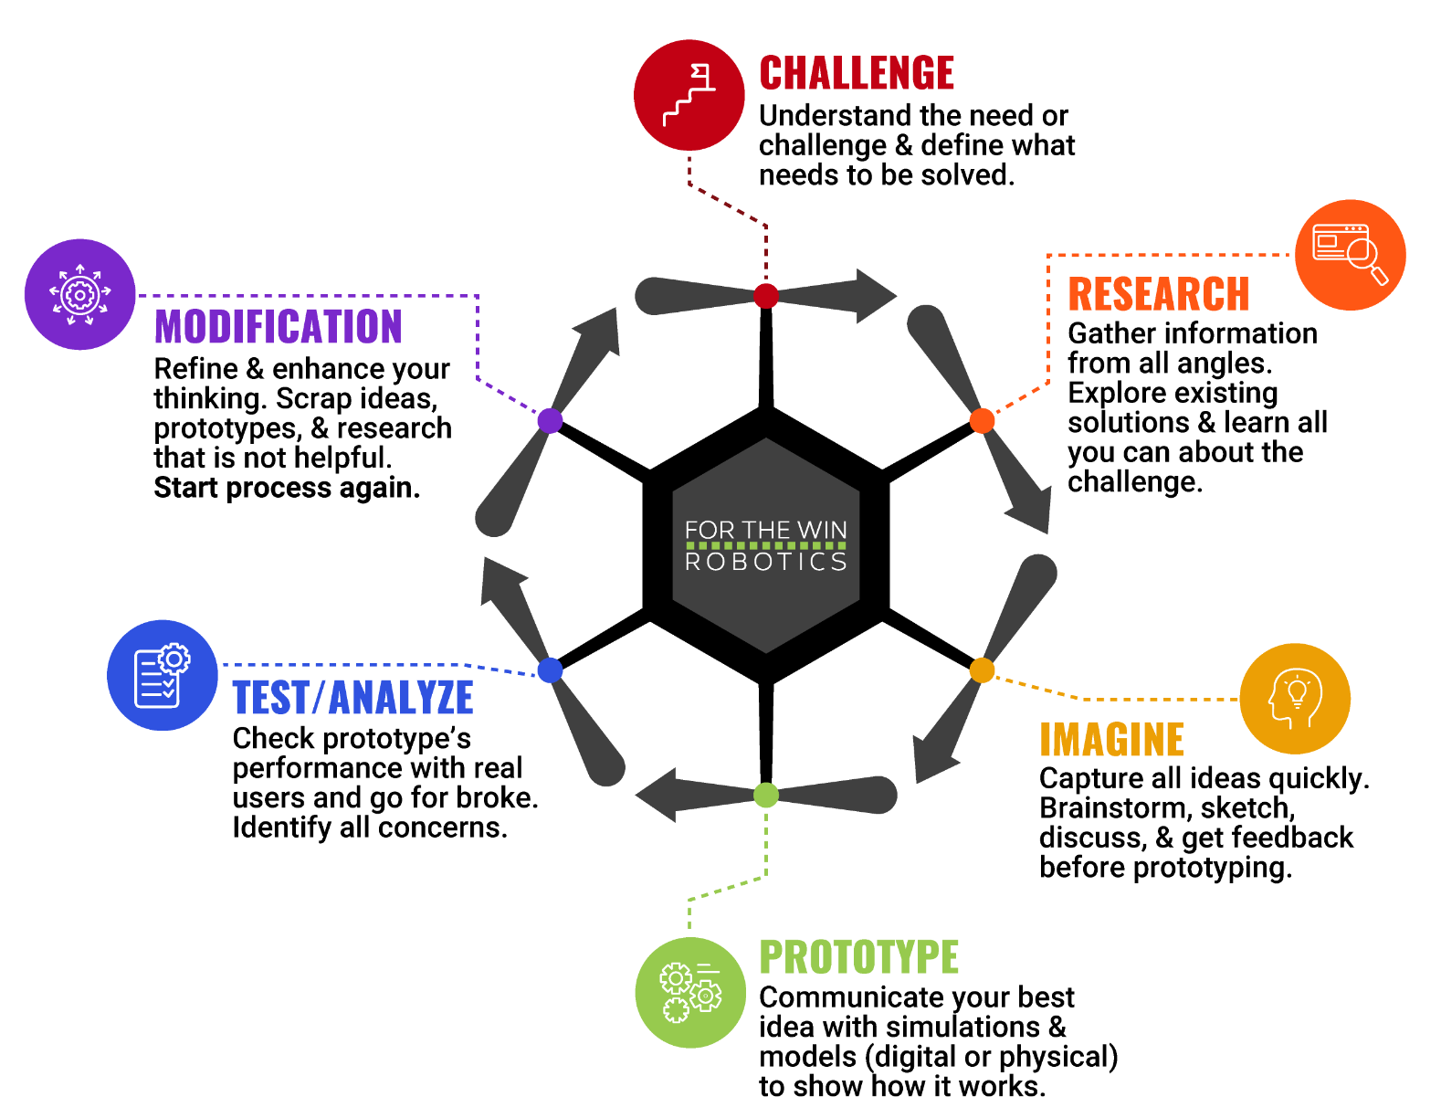
The Engineering Design Process
Let’s look at a variation of what is called the Engineering Design Process (EDP) which is a series of steps used by engineers to solve problems.

Slide 6
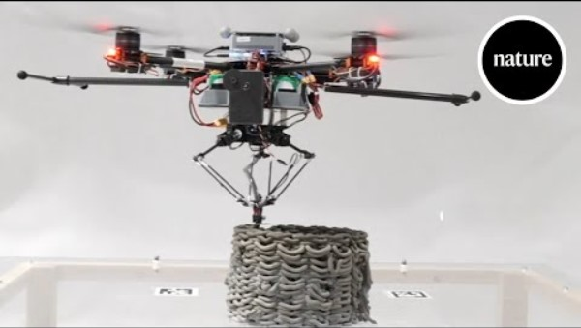
Case Study
Notes:
Nature Video “3D printing with drones”
Video length − 2:56
https://www.youtube.com/watch?v=pDKNEO0gDuE
Smithsonian Magazine Article: https://www.smithsonianmag.com/smart-news/these-3d-printing-drones-could-alter-the-future-of-construction-180980831/

Slide 7
Case Study − Engineering Design Process (EDP)
As a group, talk through the EDP of developing the 3D printing drone. Using the information given on the previous slide, how would you have designed the drone using the EDP?
Challenge
Research
Imagine
Prototype
Test/Analyze
Modification
Notes:
Example EDP discussion:
Challenge − Accurately and stably 3D print a structure using a drone.
Research − Find information such as the maximum weight the drone can carry, battery life for the drone, lightweight and pourable building materials, drone sensors available to scan structures, local regulations on flying UAVs, etc.
Imagine − A drone that has the ability to accurately create a structure through 3D printing and the ability to use sensors to check it’s work. Mock up the drone design using computer programs such as AutoCAD or other technologies.
Prototype − Find a manufacturing facility to create a prototype of the designed drone.
Test/Analyze − Test the 3D printing drone with a basic structure and confirm the accuracy of the build with the original design.
Modification − Redesign the parts of the drone that are causing any issues.
Repeat steps as many times as needed.

Slide 8
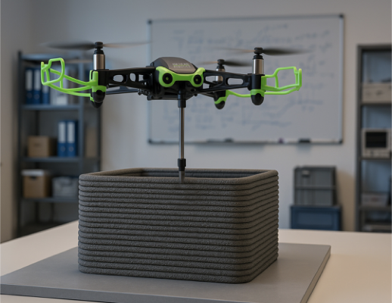
Activity Scenario
Hopper is 3D printing a storage structure that is shaped as a hollow rectangular prism with a square base. The square base needs to be
10' × 10'.
With the building material that Hopper is using, there needs to be five layers of the building material for the structure to reach 5' tall.
You will write a code to command Hopper to print five layers in a square pattern to create the storage structure. Use a loop to make your code more efficient.

