Slide 1


Drones in Firefighting
What are some ways in which fires can be extinguished?

Slide 2
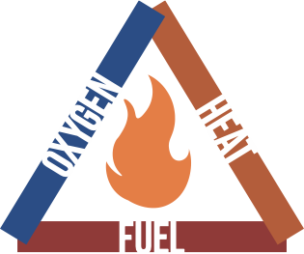
Fire Basics
Fires require three components to burn.
Oxygen − air in most cases
Heat − usually starts the fire
Fuel − anything that burns
Fires can be extinguished by taking away any one of these components. Some of these methods are:
Applying water to lower the temperature of the fire.
Covering the fire with a fire blanket to cut off the supply of oxygen.
Turning off a gas valve to cut off the fuel supply.

Slide 3
Group Discussion Questions on Fires
What are some natural disasters and accidents that could start fires?
What are some locations that firefighters might respond to?
Why might drones be useful in firefighting?
What could be some advantages of using drones?
What could be some disadvantages of using drones?
Notes:
Example discussion topics:
Lightning, campfires, flares, fireworks, electrical wires, arson, volcanoes, etc.
Forests, deserts, grasslands, commercial buildings, residential buildings, etc.
Advantages: bird’s eye view, situational awareness, safety, quicker response, potential cost saving, data collection, etc.
Disadvantages: limited battery life, potential cost expense, vulnerable to weather, airspace safety, etc.

Slide 4
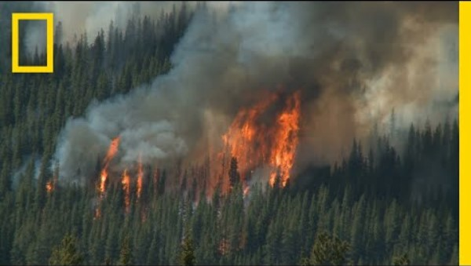
Wildfires
Wildfires are fires that are started in an area of vegetation, such as a forest or a desert.
Notes:
National Geographic “Wildfires 101”
Video length − 3:12
https://www.youtube.com/watch?v=5hghT1W33cY

Slide 5
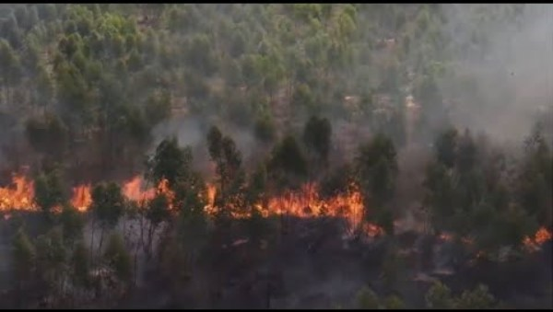
How Can Drones Be Used to Fight Wildfires?
Drones can be used in fighting wildfires for situational awareness, as well as for detecting fires using infrared cameras which can see through smoke.
Notes:
Transport Canada “Drones for Good: wildfires”
Video length − 2:33
https://www.youtube.com/watch?v=R6pmpo1ucPA

Slide 6
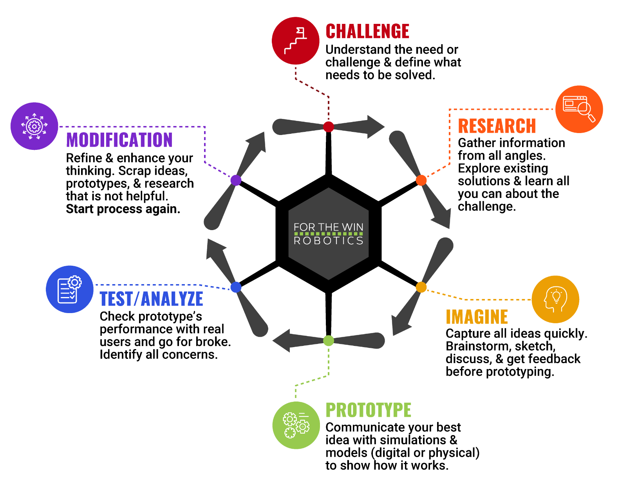
The Engineering Design Process
Let’s look at a variation of what is called the Engineering Design Process (EDP) which is a series of steps used by engineers to solve problems.

Slide 7
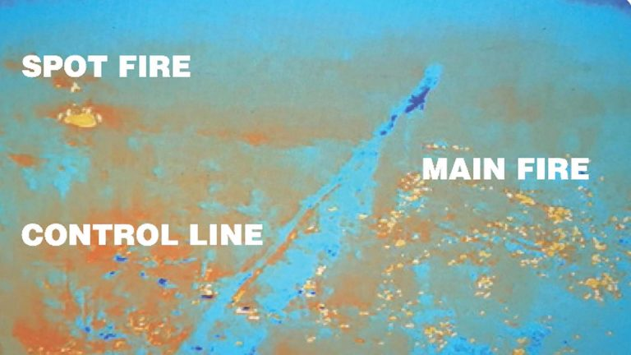
Case Study
In August 2017, lightning storms started dozens of fires in southern Oregon which were exacerbated by gusty winds. A drone was used at the Umpqua National Forest to identify a spot fire (a fire that starts outside the main fire) that could have destroyed $50 million in infrastructure and property damage if it spread. (Reported by KOBI News.)
According to a report from the USDA: “New technology filled some of the gaps. Unmanned aerial systems – or drones – scouted lines, gauged fire behavior and sensed heat with infra-red cameras. Since drones can fly in low light, drones – still uncommon tools at wildfires -- could even look for spot fires during evening burn operations.”
Notes:
KOBI News Article: https://kobi5.com/news/71386-71386/
*Educators are encouraged to find case study examples local to their area. Be sensitive to events that may have had a direct negative impact on any students.

Slide 8
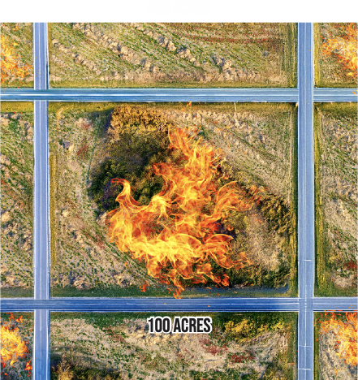
Activity Scenario
You are using Hopper to monitor a wildfire in an area of a 400-acre square. The main fire is within a 100-acre square that is surrounded by roads which are acting as control lines.
You will work with your team to identify any spot fires outside of the control lines of the main fire using Hopper’s camera. Then, you will mark the locations of the spot fires on a scaled diagram.

