Slide 1


Drones in Firefighting
What could be some benefits of intentionally setting fires in areas of vegetation?

Slide 2
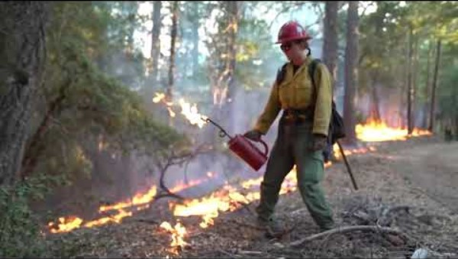
Prescribed Fires
Prescribed fires are fires that are carefully planned and intentionally set by firefighters or land managers.
Notes:
US Forest Service
“Good Fire: Prescribed Burning”
Video length − 2: 41
https://www.youtube.com/watch?v=E542gY7uR0s

Slide 3
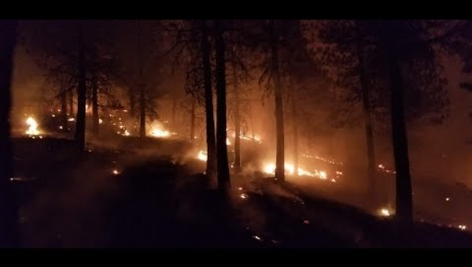
Prescribed Fires
Notes:
US Forest Service
“The Story of Prescribed Fire - A vital part of Western landscapes”
Video length − 5:13
https://www.youtube.com/watch?v=XpZemPMRkDw

Slide 4
Group Discussion Questions on Prescribed Fires
How could drones be used in setting prescribed fires?
What could be some advantages of using drones?
What could be some disadvantages of using drones?
What kinds of technologies for drones could be useful in setting prescribed fires?
Notes:
Example discussion topics:
Advantages: safety, access to more remote locations, complete tasks quicker, etc.
Disadvantages: accuracy, limited battery life, etc.
Infrared camera, GPS, night vision camera, etc.

Slide 5
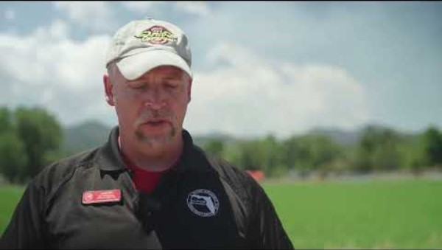
How Can Drones Be Used to Set Prescribed Fires?
Drones can be used to set prescribed fires, called UAS aerial ignition.
Notes:
US Forest Service “UAS Aerial Ignition video”
Video length − 1:35
https://www.youtube.com/watch?v=oGE7oIaFTVo

Slide 6
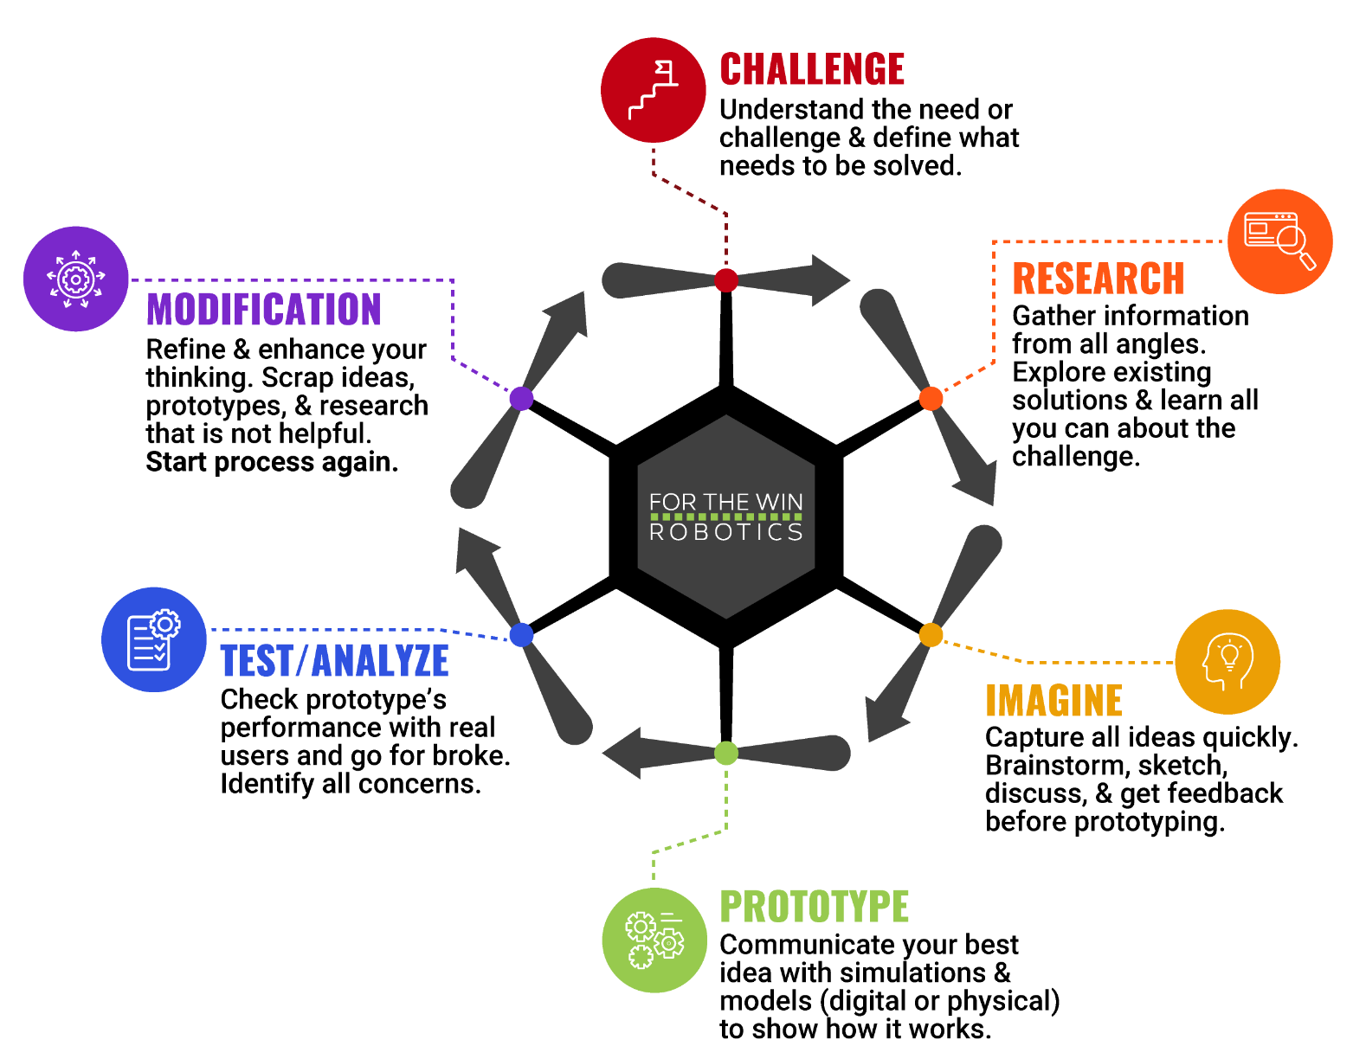
The Engineering Design Process
Let’s look at a variation of what is called the Engineering Design Process (EDP) which is a series of steps used by engineers to solve problems.

Slide 7
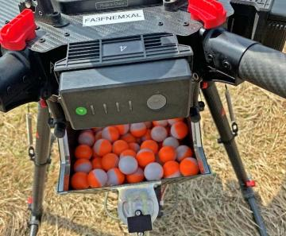
Case Study
In April 2021, the Monongahela National Forest in West Virginia became one of the many places where UAS aerial ignition has been adopted. The staff first used drones for prescribed fires in the 1,005 acre Ramshorn project area where they have previously ignited prescribed fires by hand or with helicopters. “The UAS dropped small biodegradable spheres . . . containing potassium permanganate on the project area.”
According to the assistant fire management officer, “When the Ramshorn unit is ignited by hand, it takes two days to complete the burn. With the additional support of the UAS, we were able to ignite the unit early, allowing smoke to disperse throughout the day, and complete the project in one day.” (Reported by the US Forest Service.)
Notes:
US Forest Service Article: https://www.fs.usda.gov/inside-fs/delivering-mission/sustain/just-jetsons-not-quite-monongahela-national-forest-adopts-uas
*Educators are encouraged to find case study examples local to their area. Be sensitive to events that may have had a direct negative impact on any students.

Slide 8
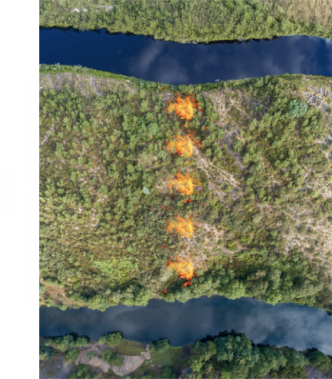
Activity Scenario
You are using Hopper to ignite 5 equally-spaced dot fires between two streams. The streams are control lines and they are 20 feet apart. The first and last dot fires should be the same distance away from each control line.
You will write and solve an equation that represents this scenario with the unknown d representing the distance between each dot fire. Then, you will write code Hopper using a loop to fly across the fire zone and place (by hovering) 5 equally-spaced dot fires.

